Slide 1
Forensic Investigation of Eufy Video Doorbell
Teardown, Chip-off , and Image Acquisition

Slide 2
Teardown

Slide 3
Teardown Process
The eMMC is the internal local storage.
It is housed in the Eufy Hub called HomeBase 2.
To locate the eMMC, we need to disassemble the Eufy HomeBase 2.
Begin by removing the screws on the bottom of the HomeBase 2.
Carefully separate the casing to reveal the internal components.
Locate the main circuit board within the HomeBase 2.
The eMMC chip is typically mounted on the main circuit board.

Slide 4
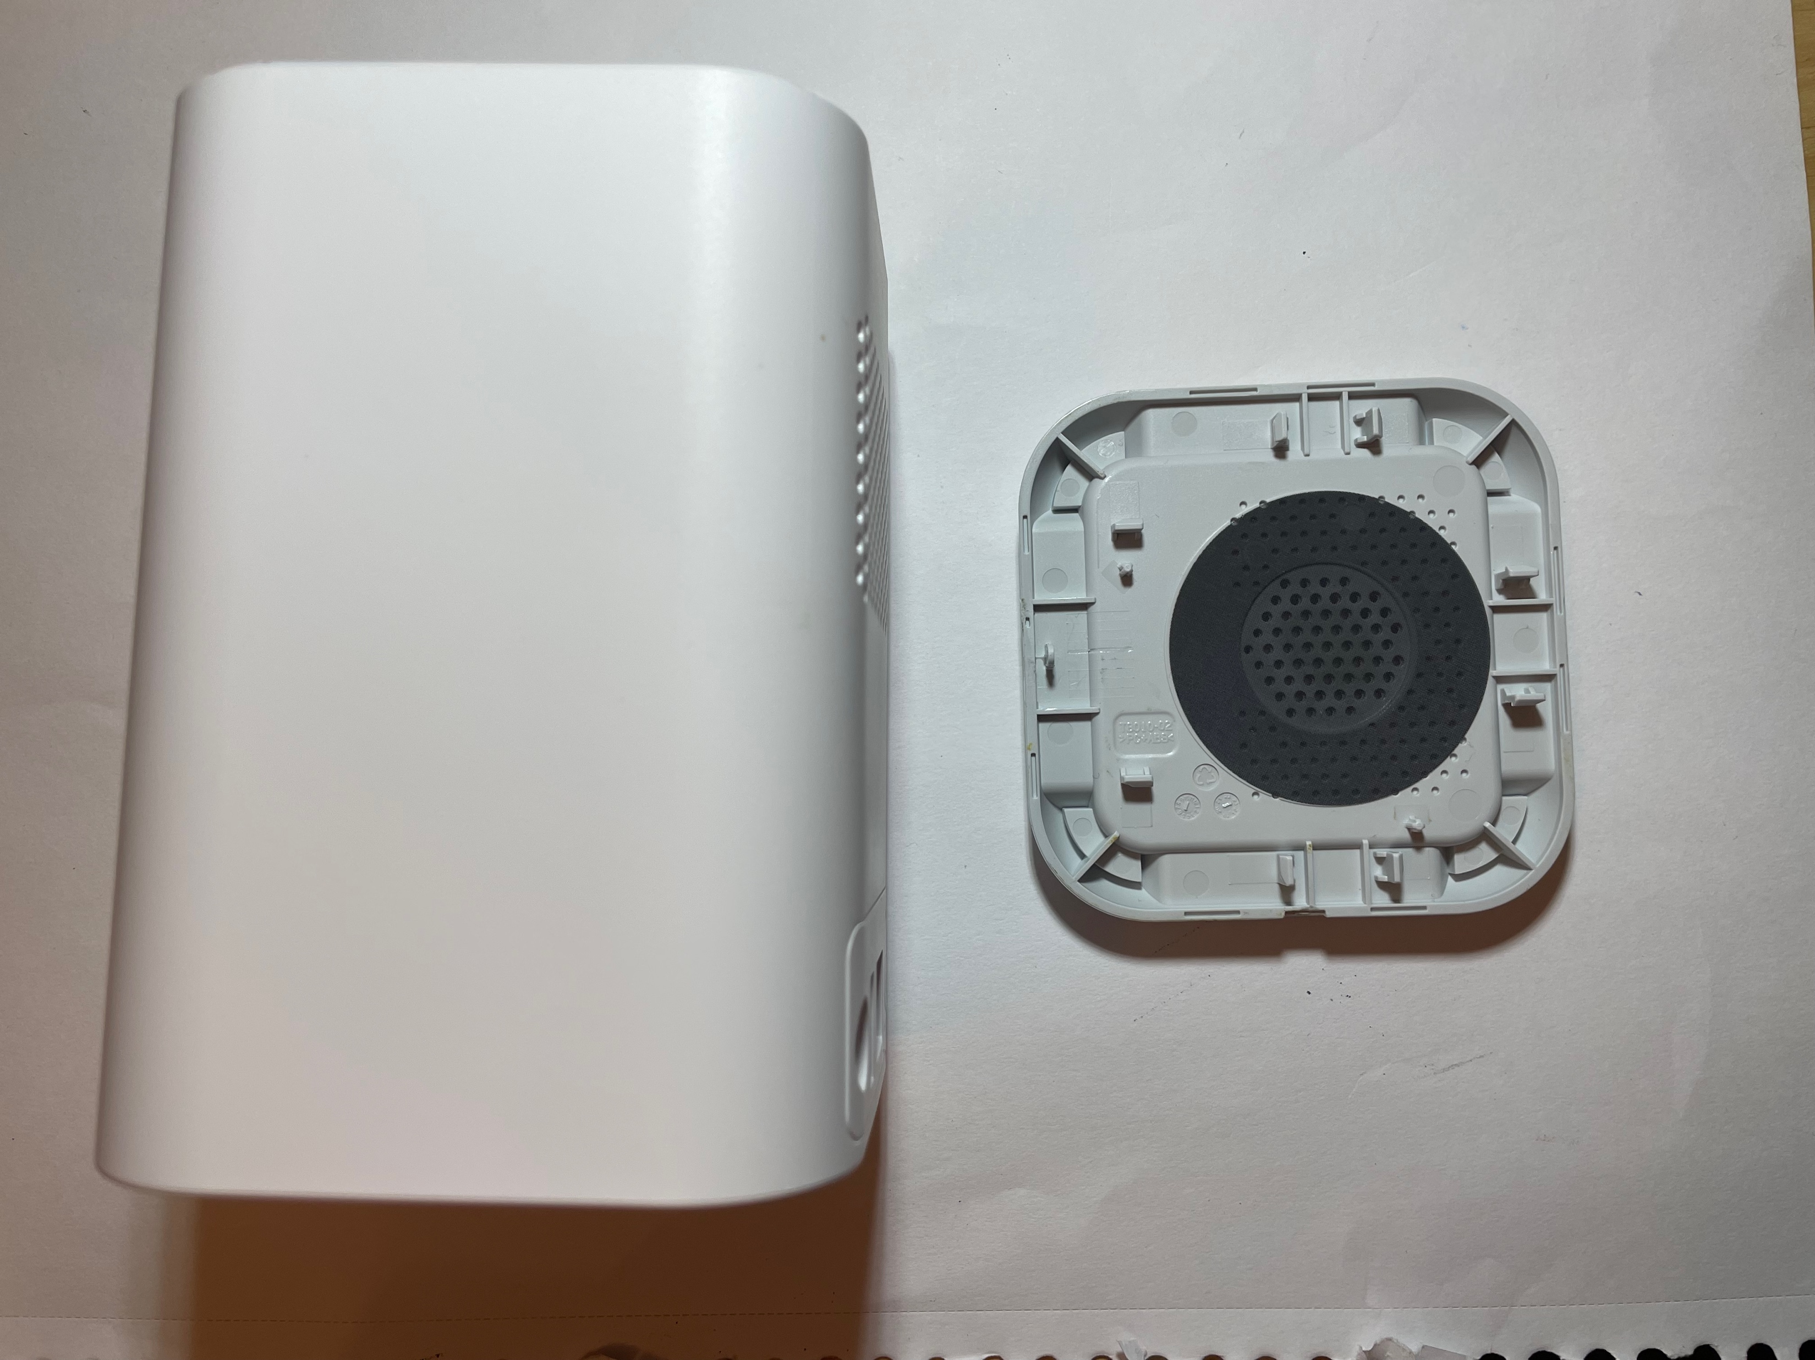
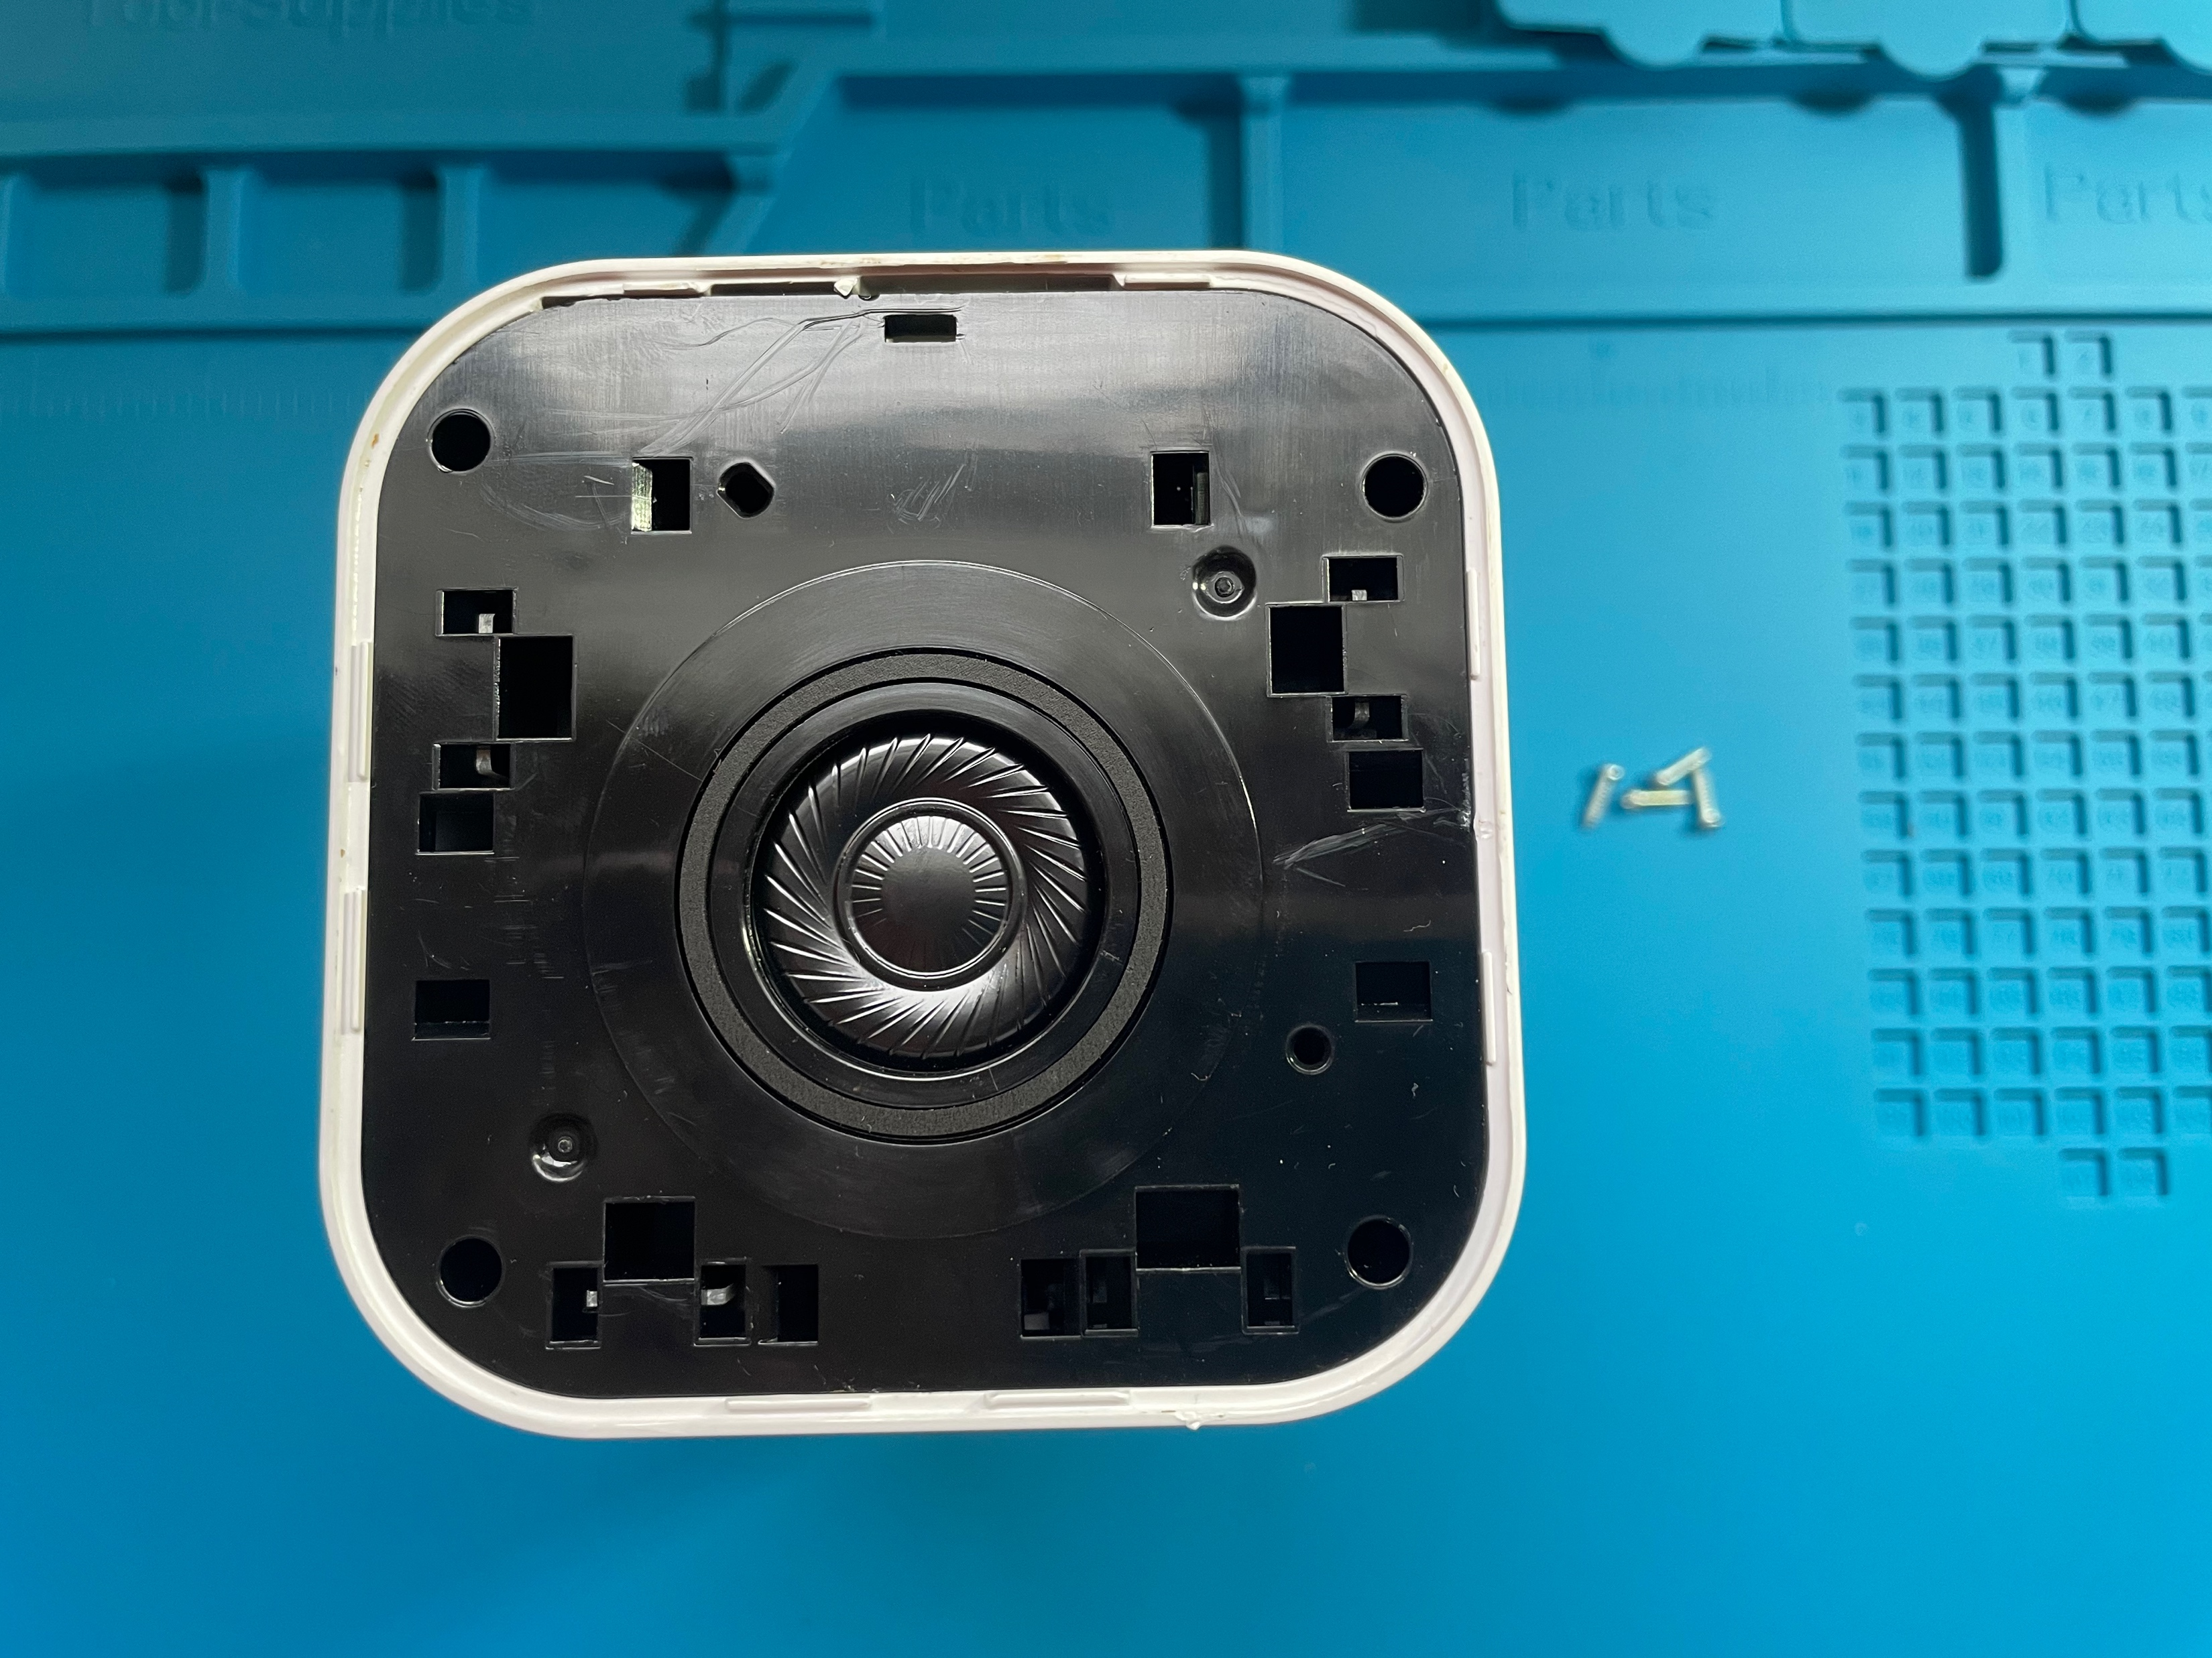
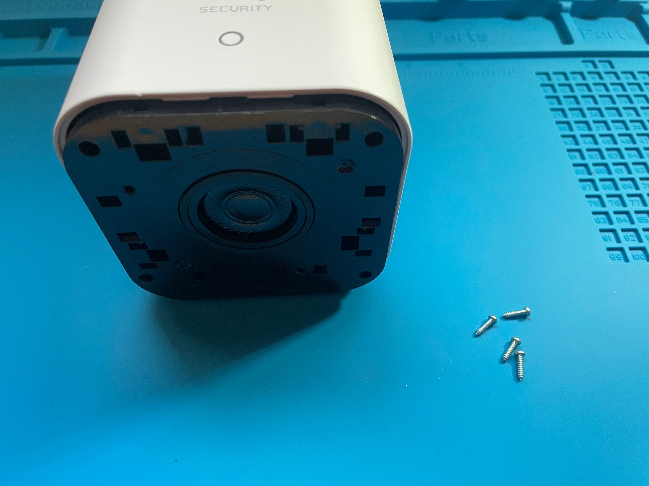
Remove back cover, then remove screws to detach circuit board from case

Slide 5
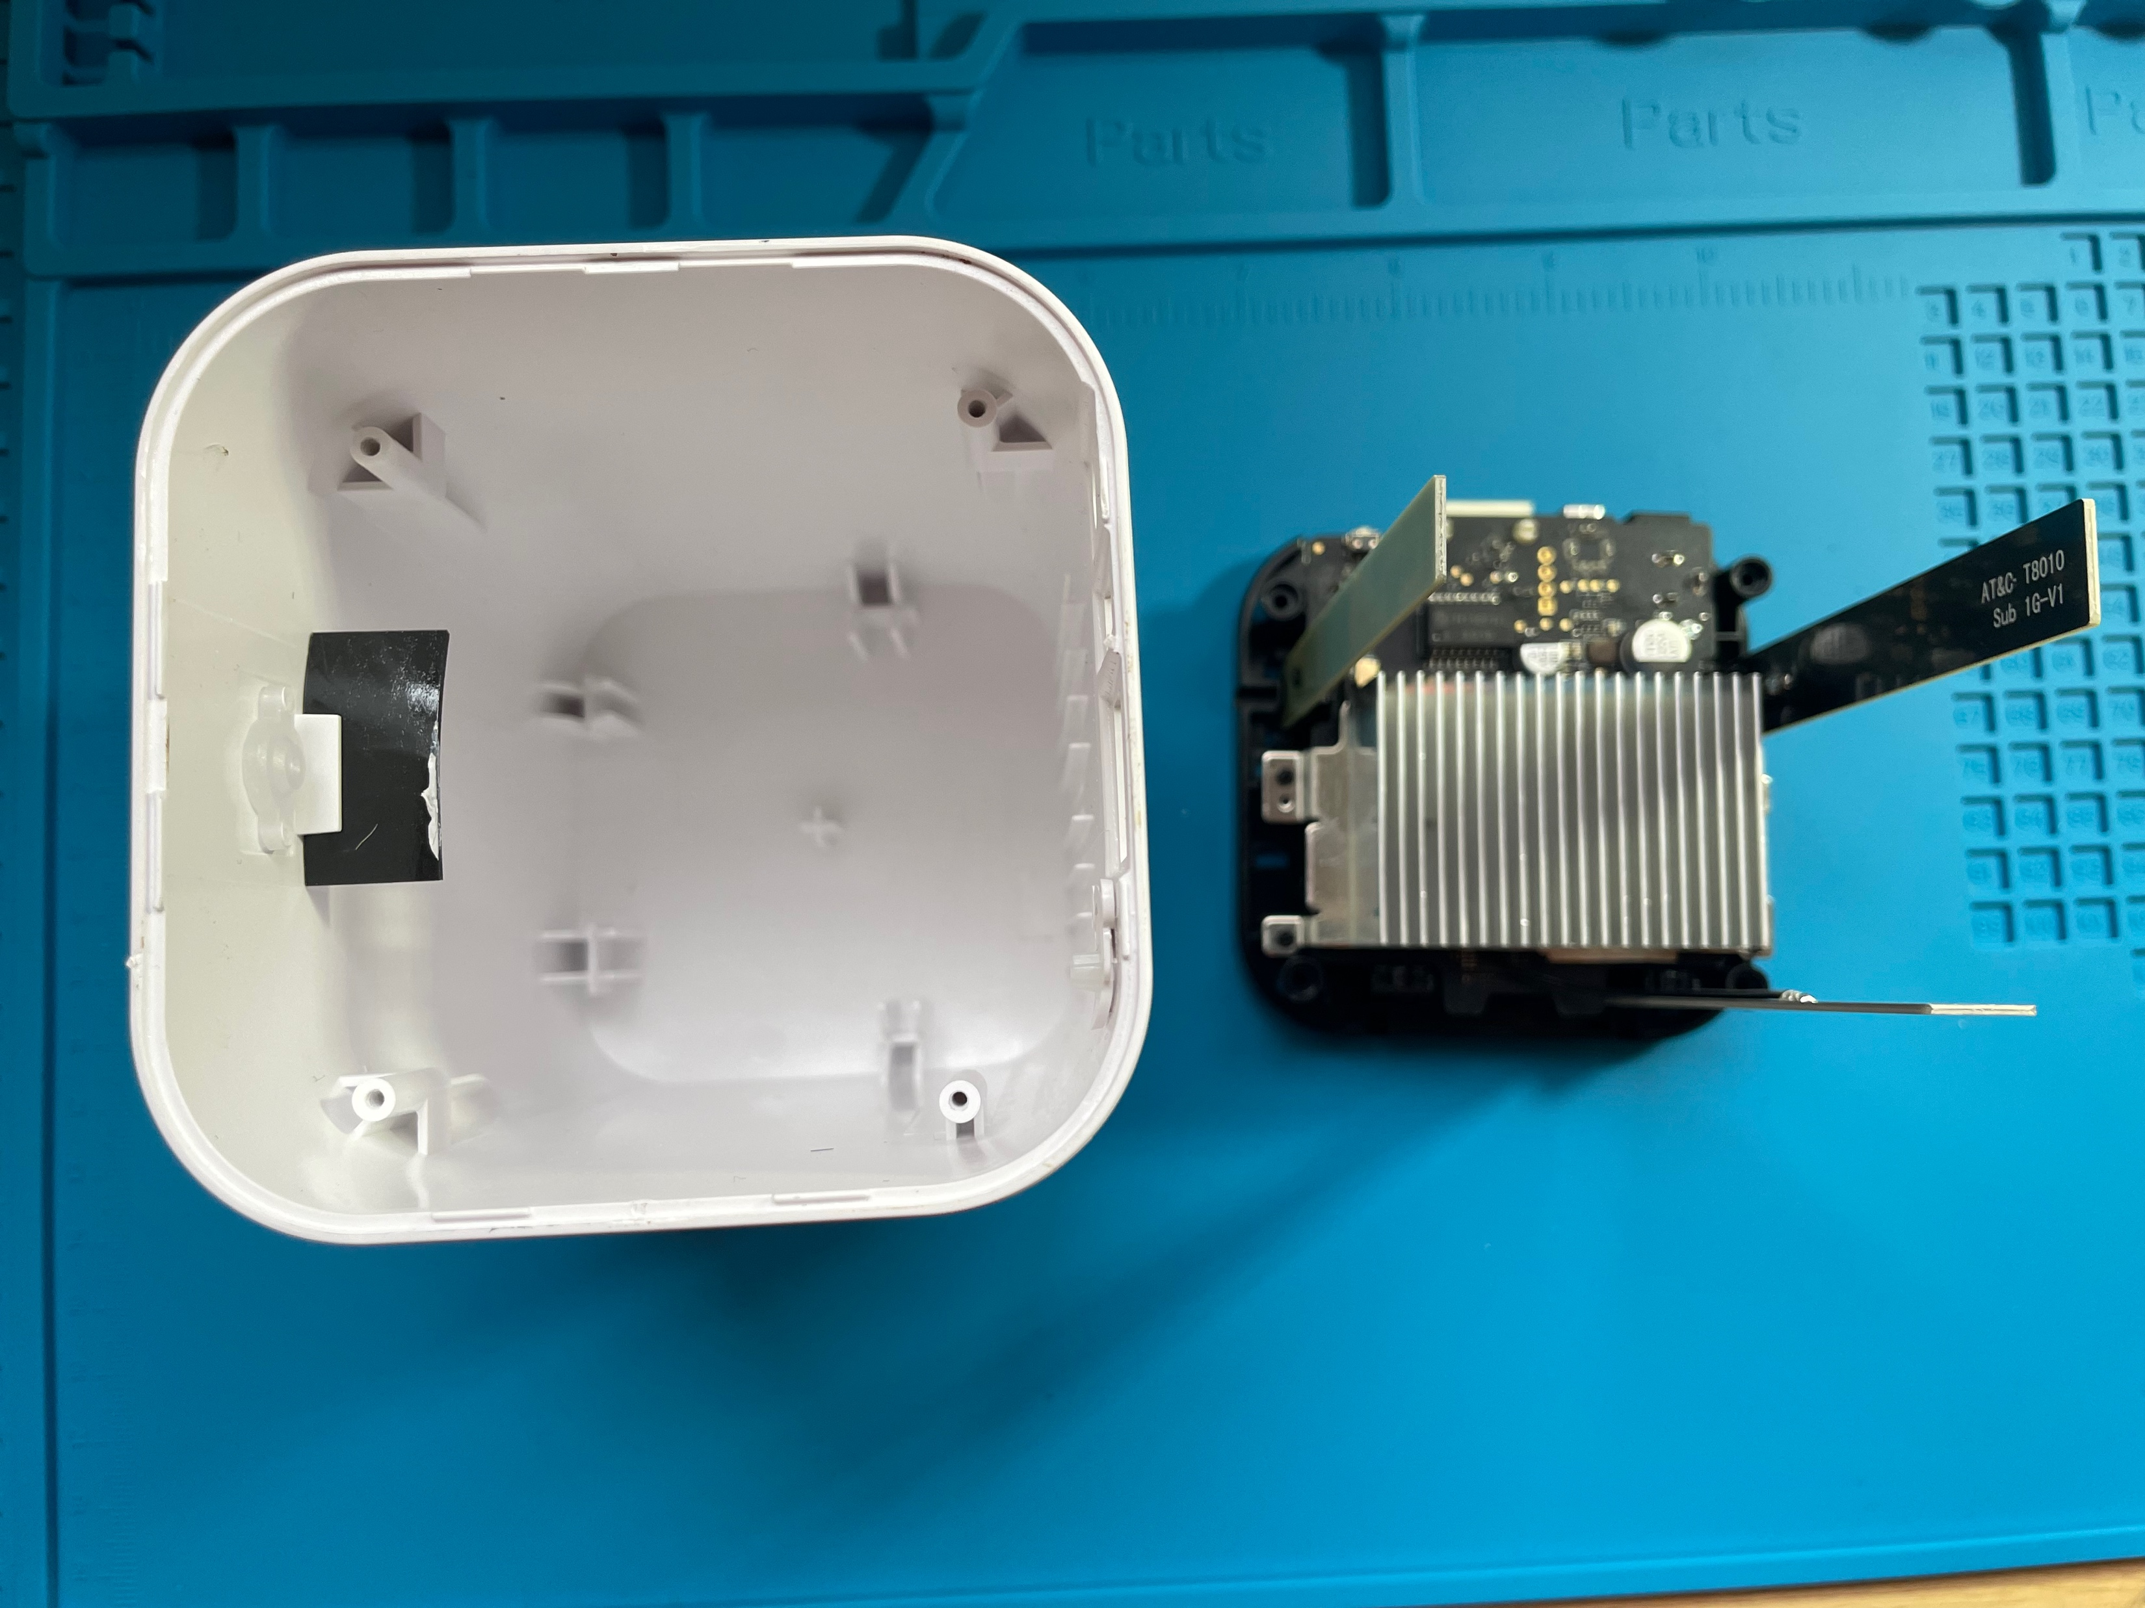
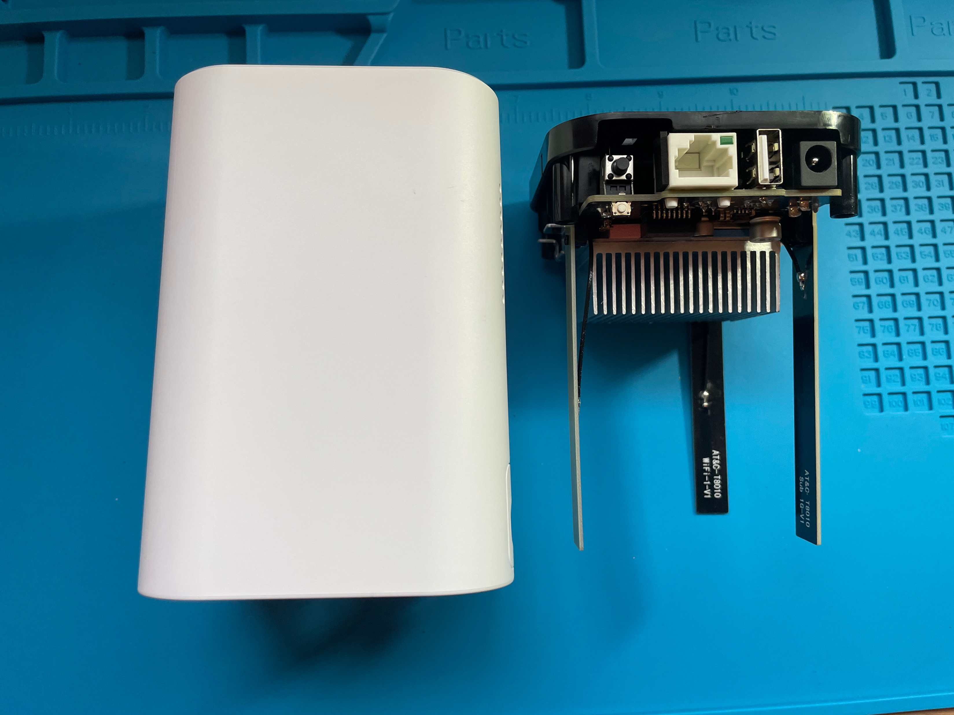
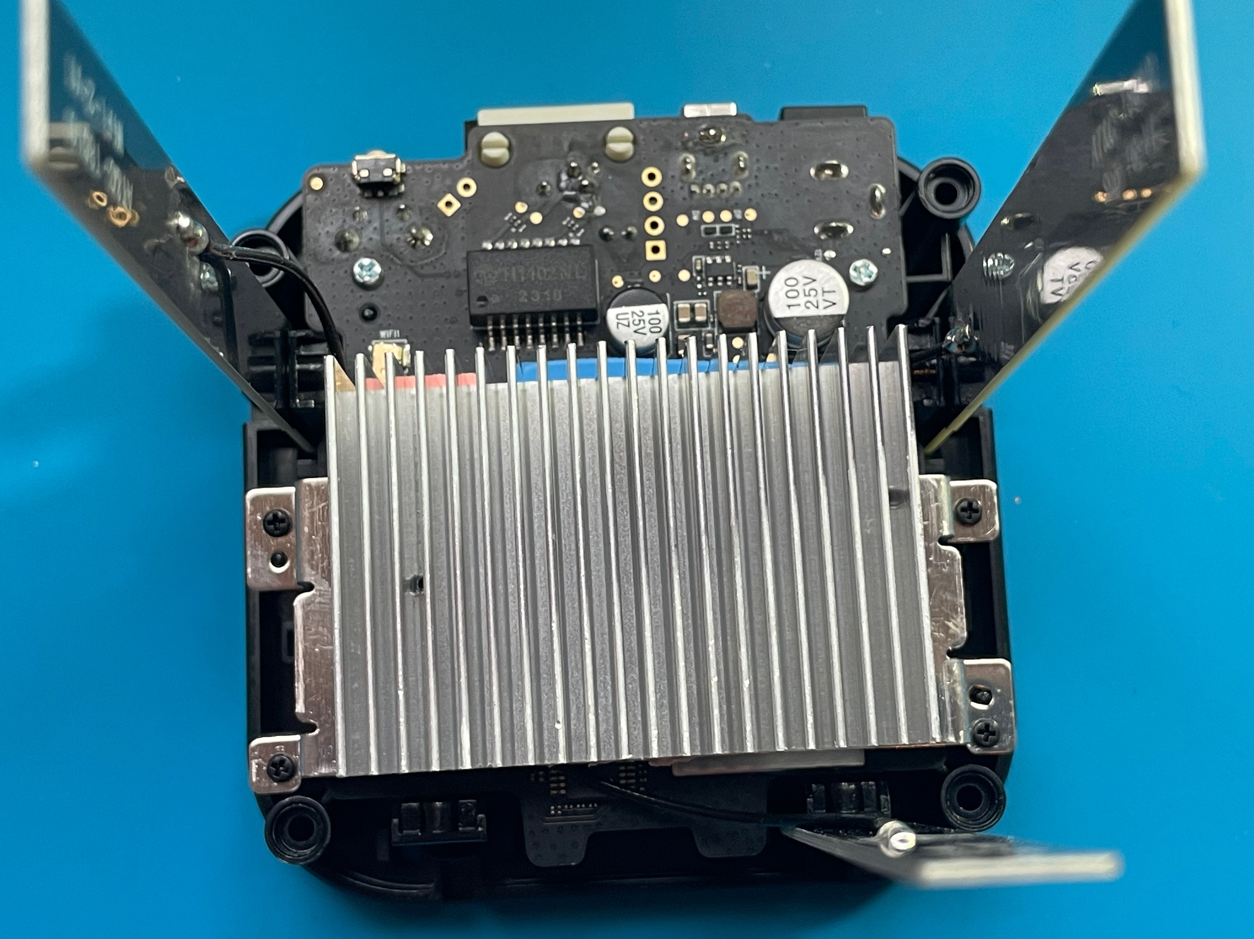
Pull circuit board out from case
Heat sink

Slide 6
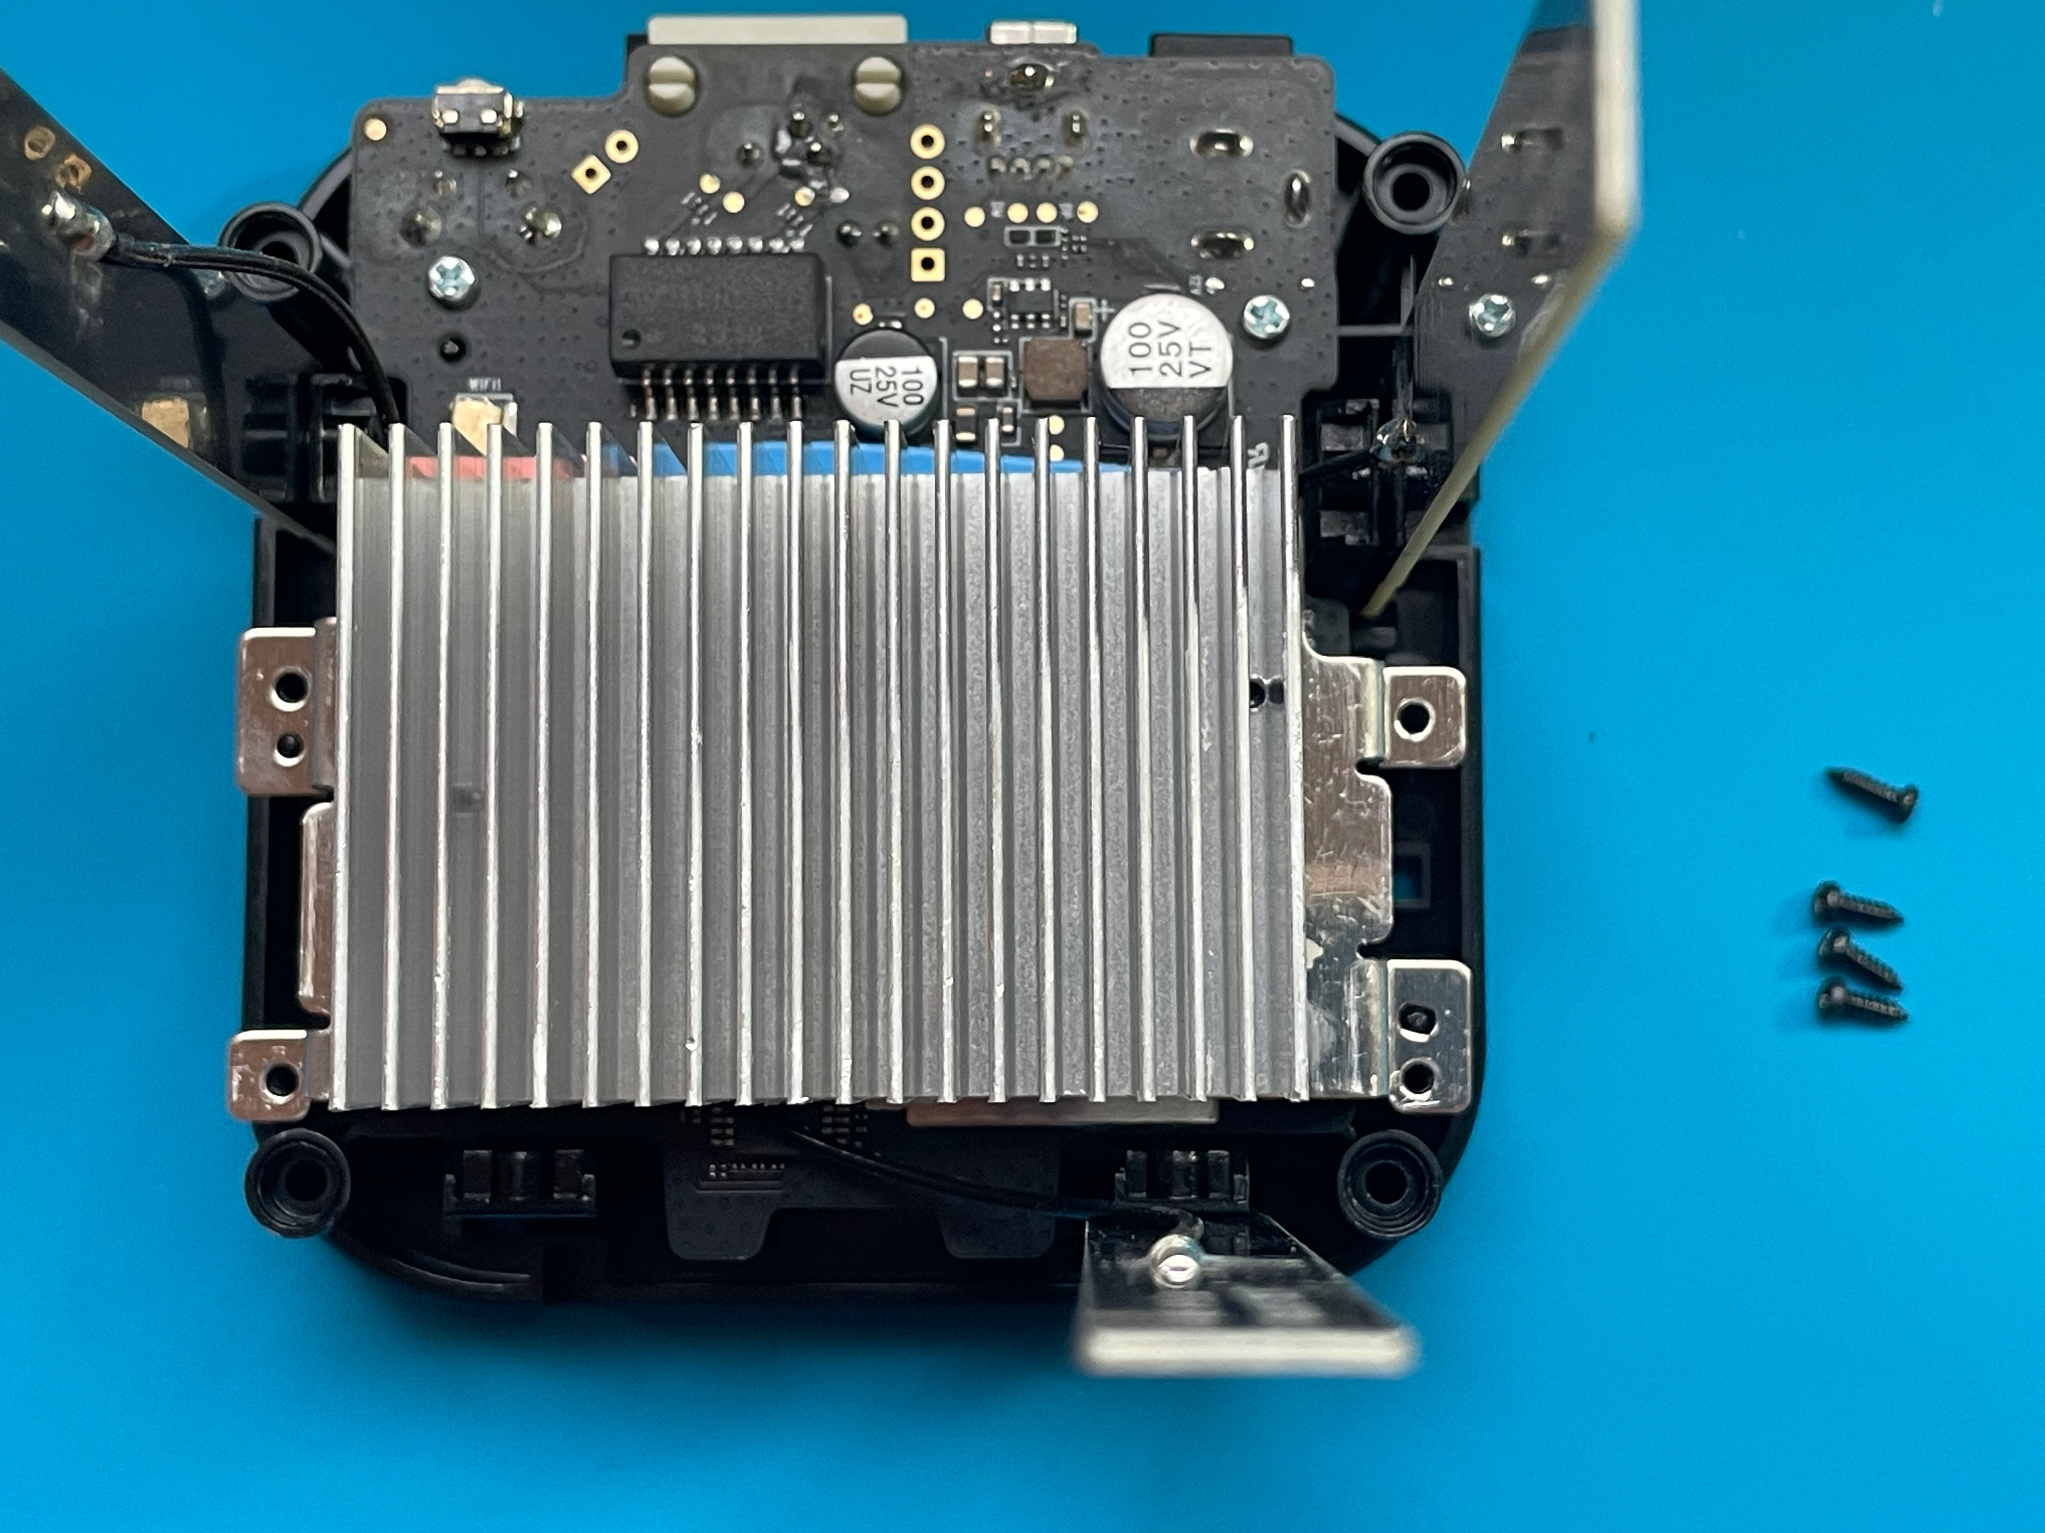
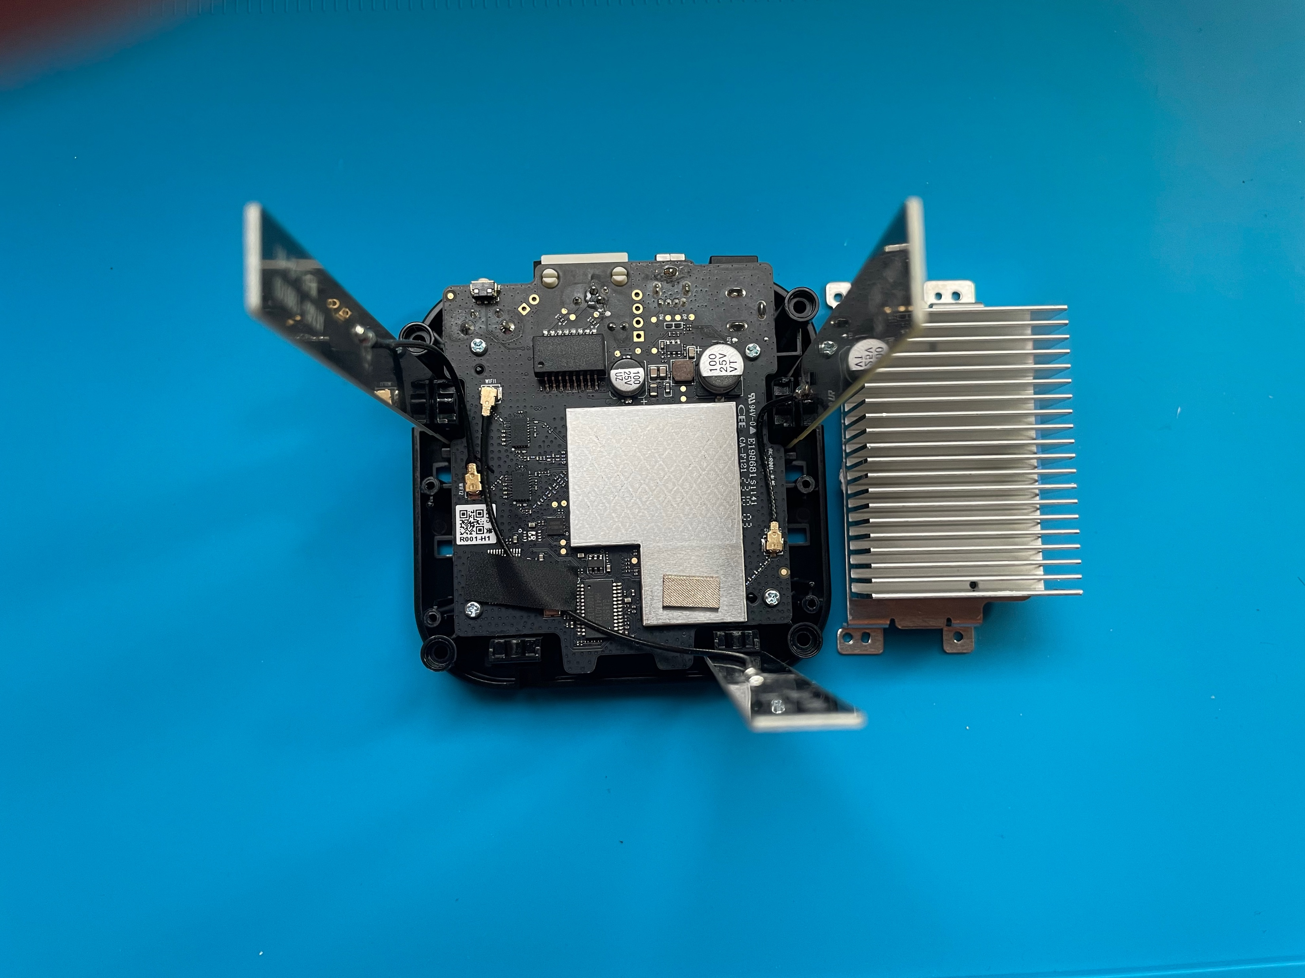
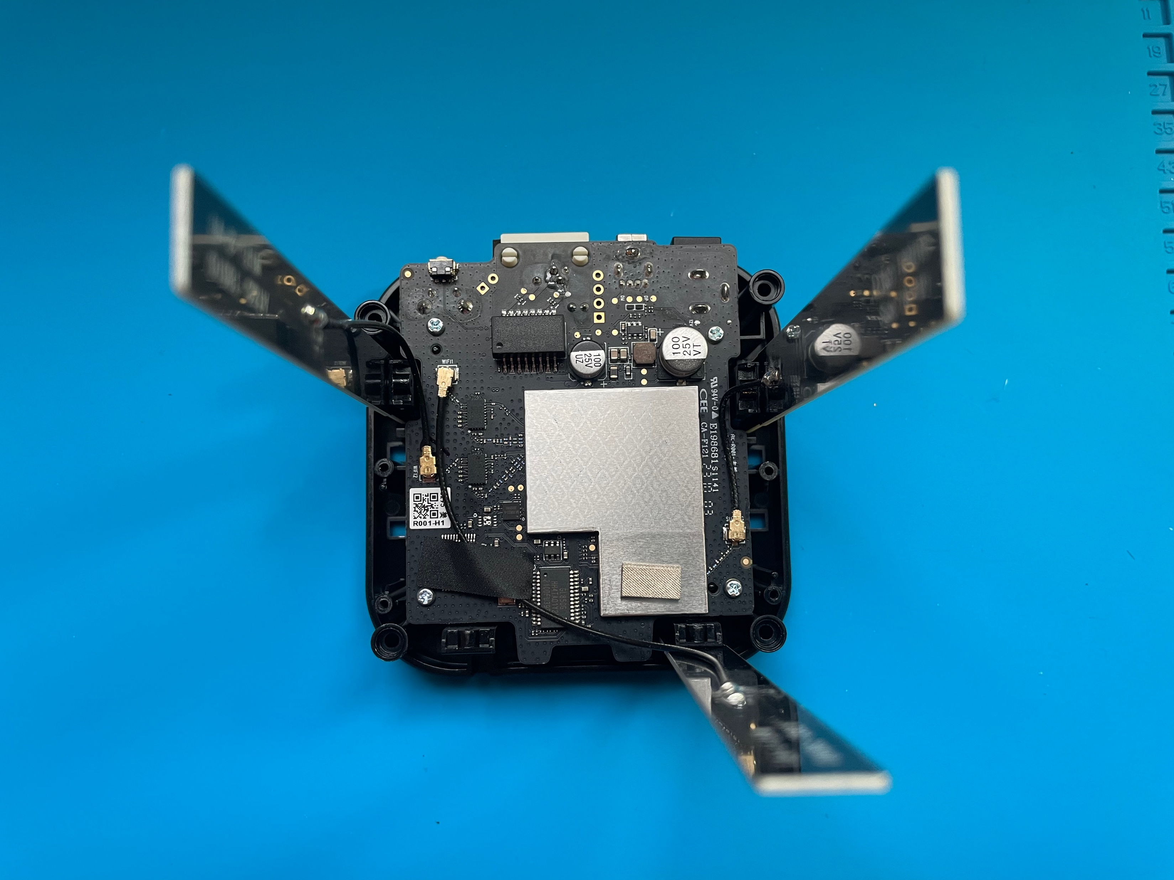
Remove screws to detach the heat sink

Slide 7
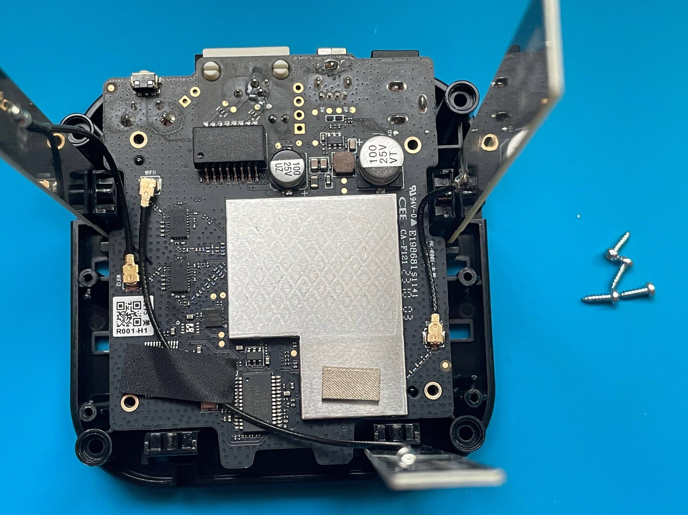
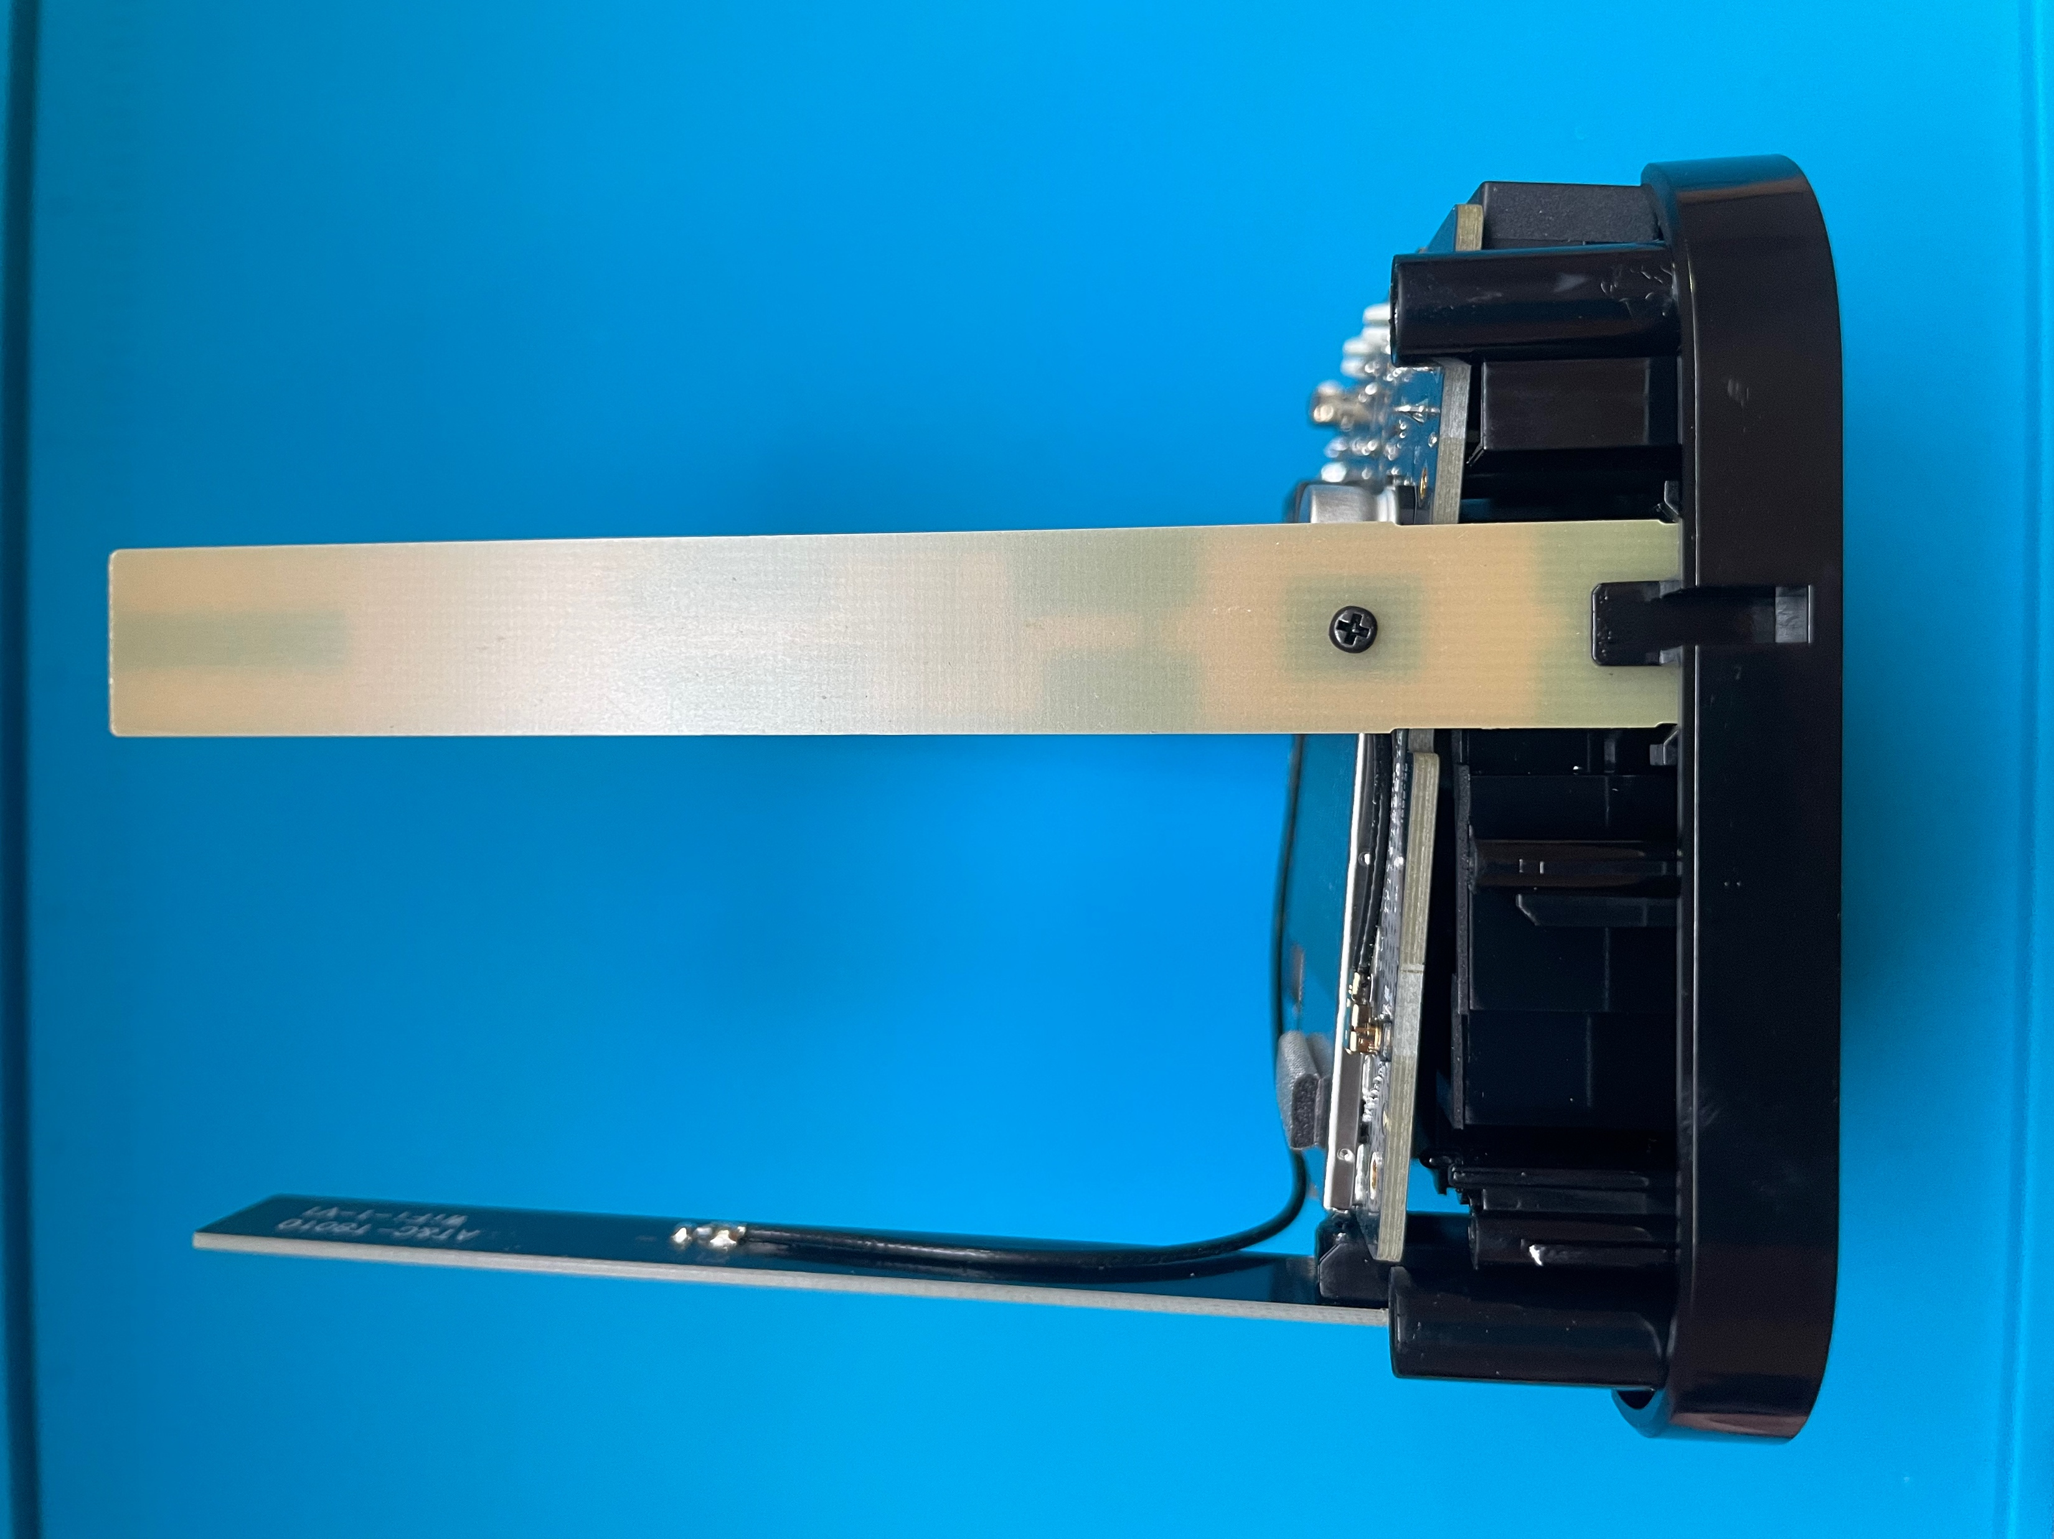
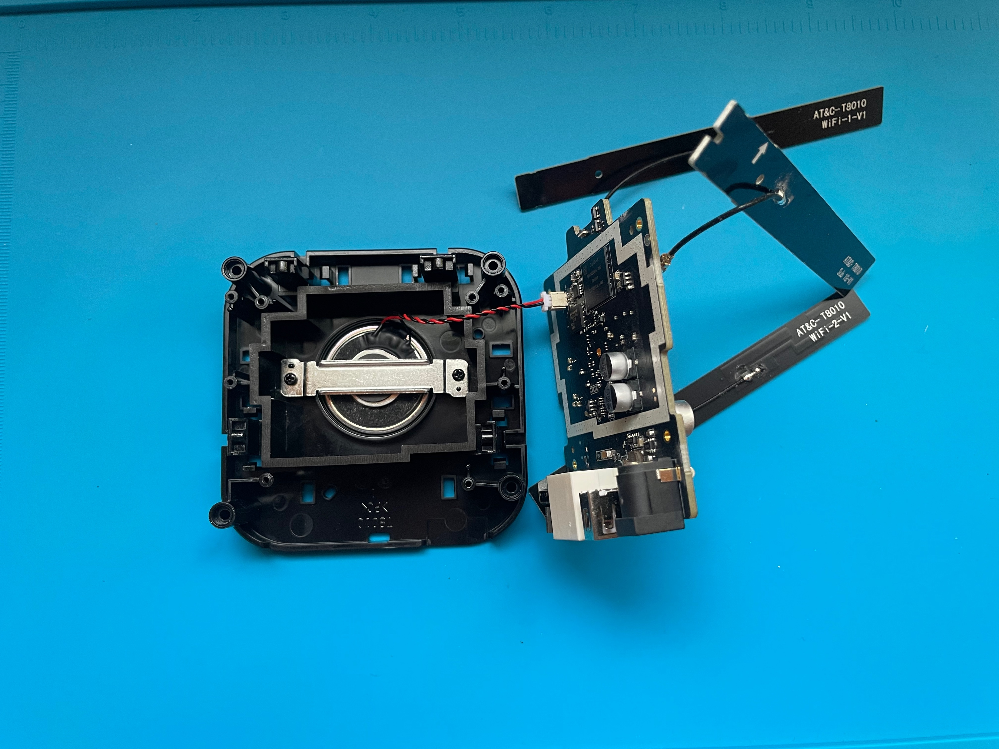
Remove screws to detach the board from base

Slide 8
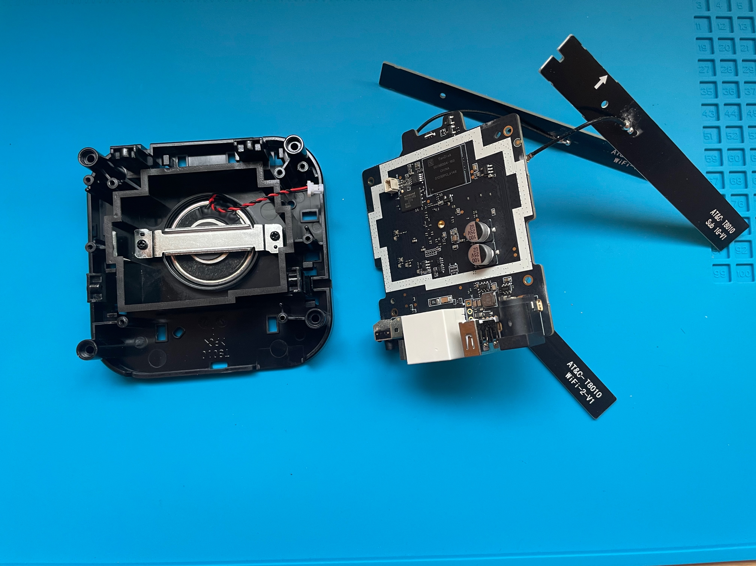
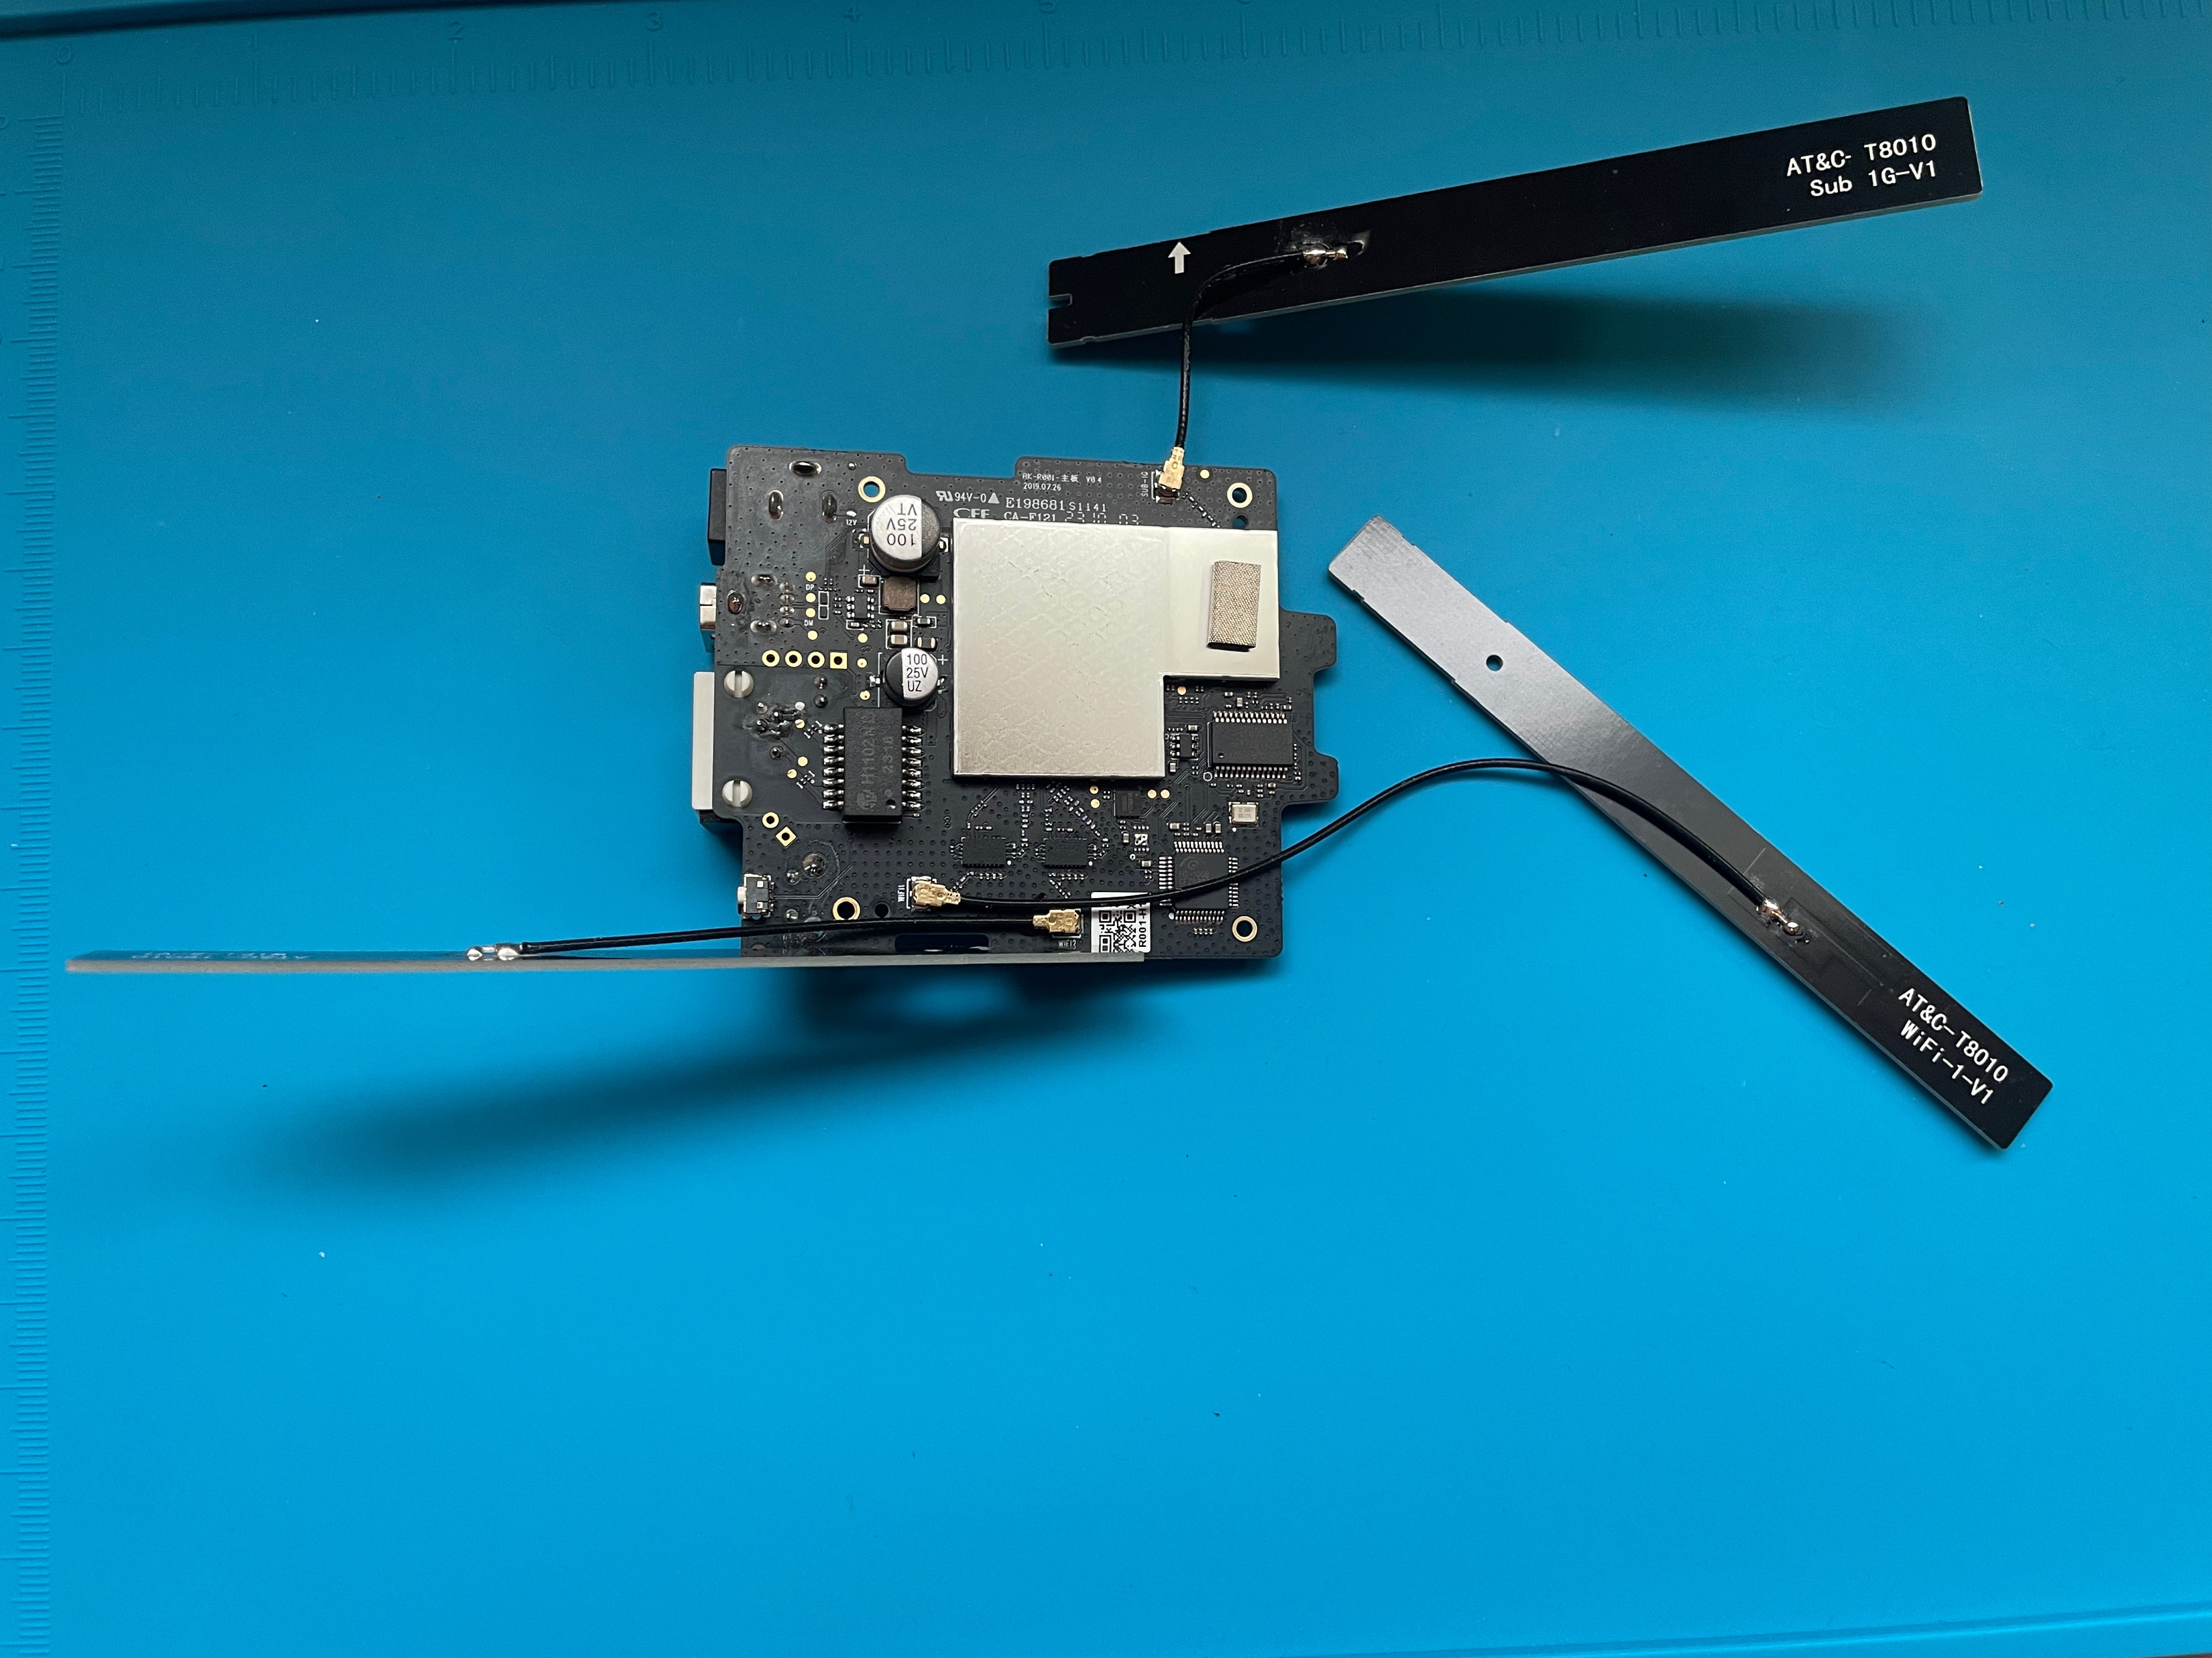
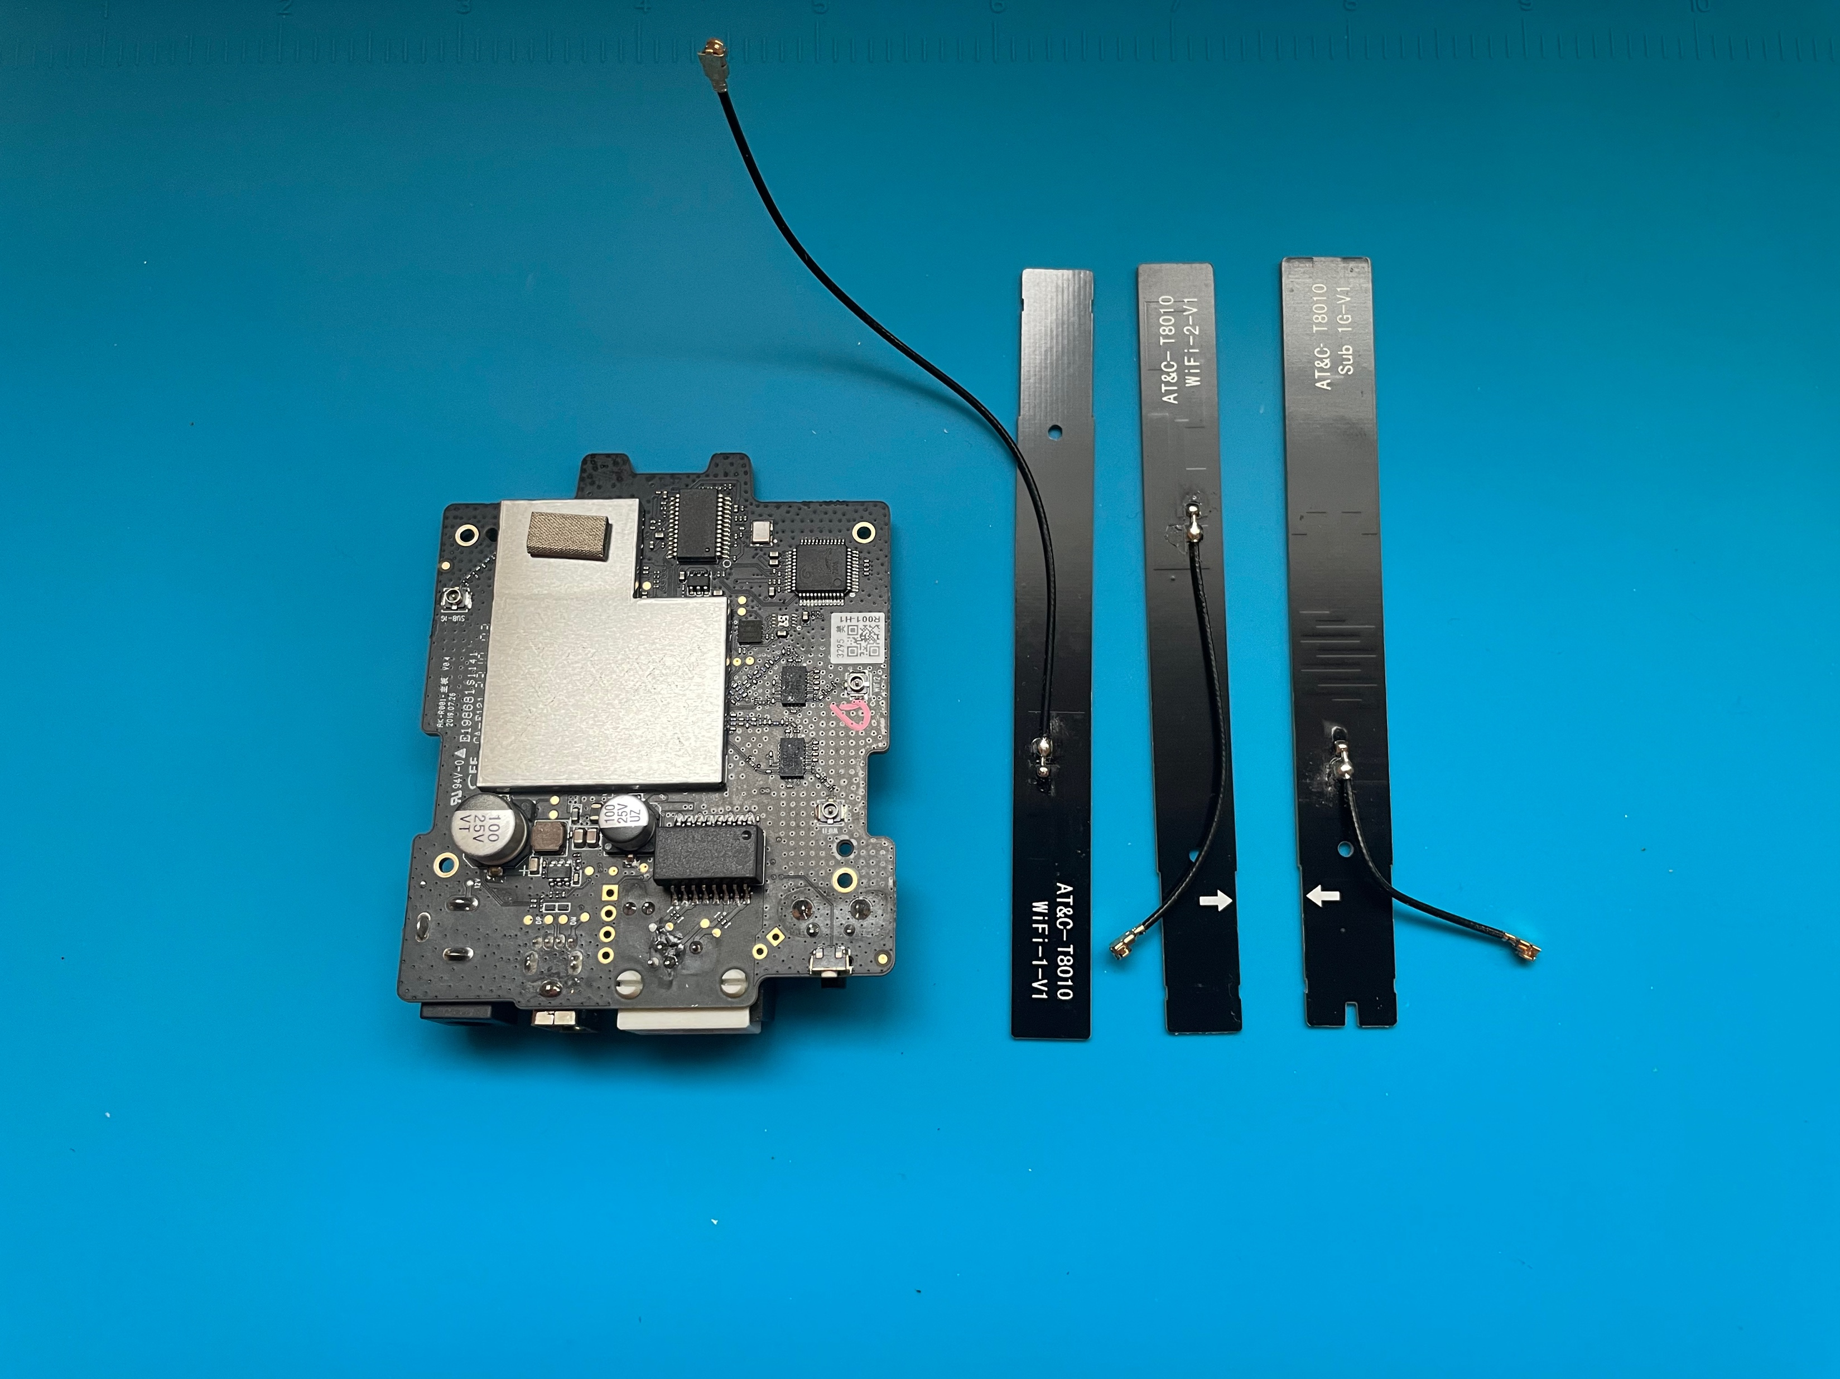
Detach wired connections
Circuit board

Slide 9
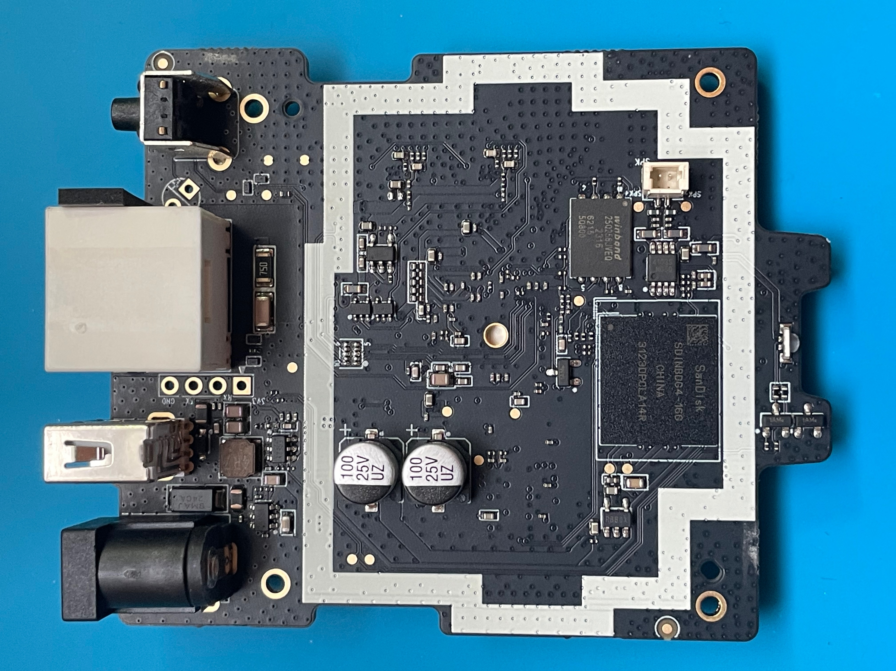
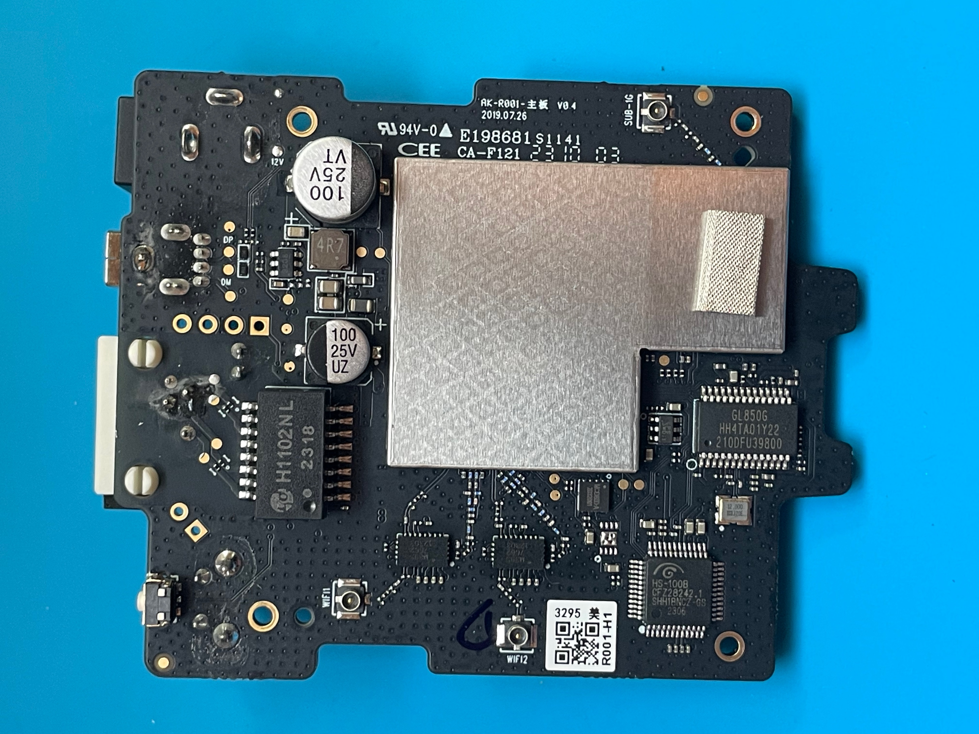
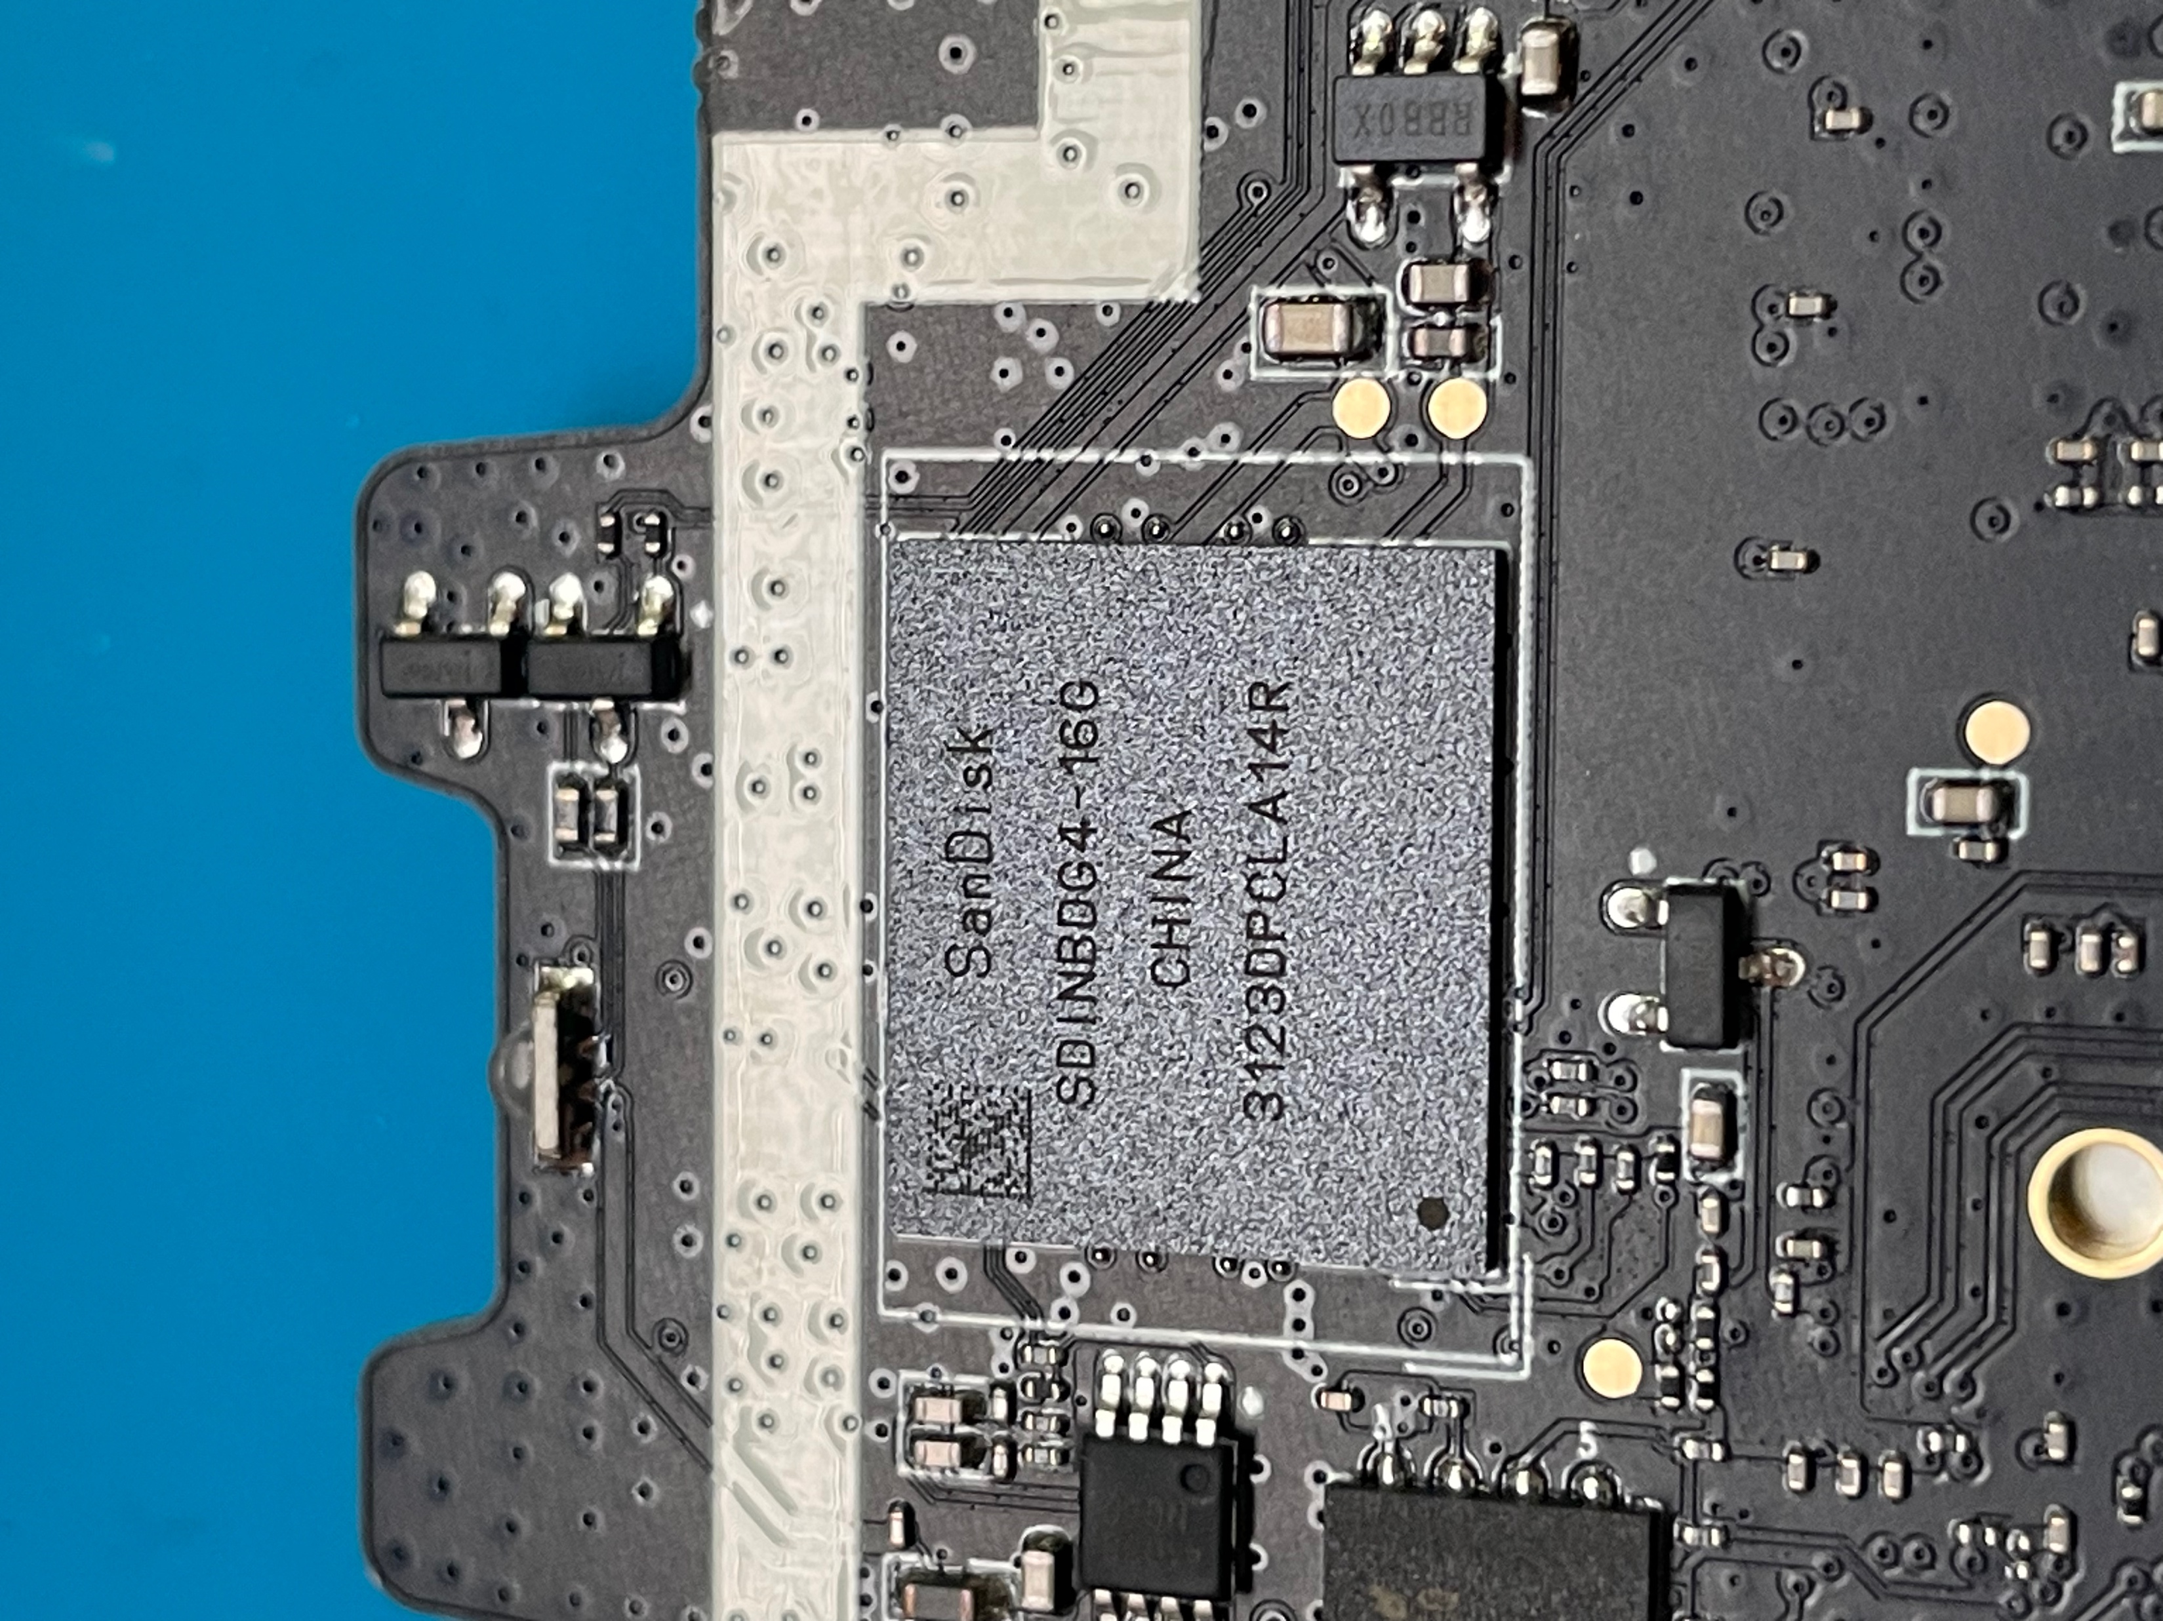
Board housing eMMC
eMMC

Slide 10
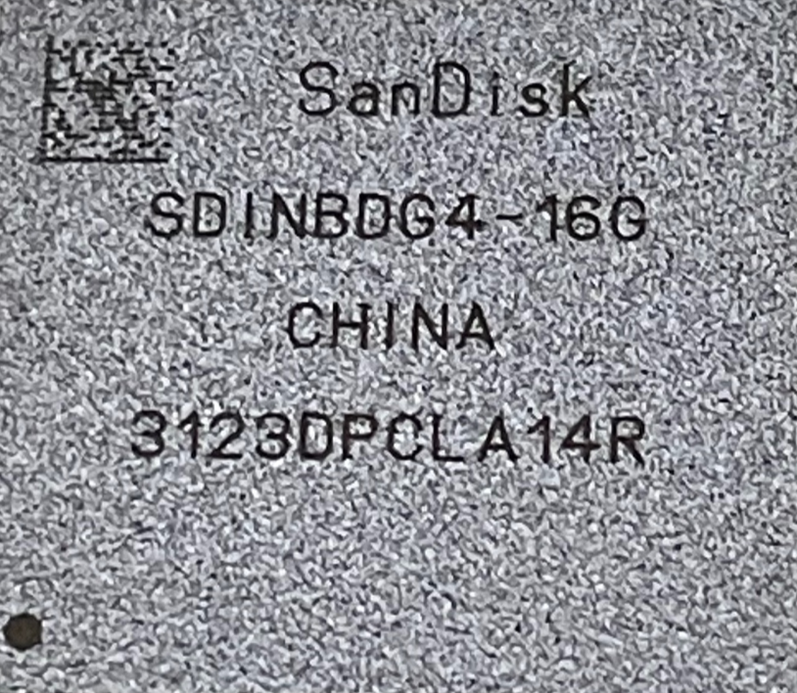
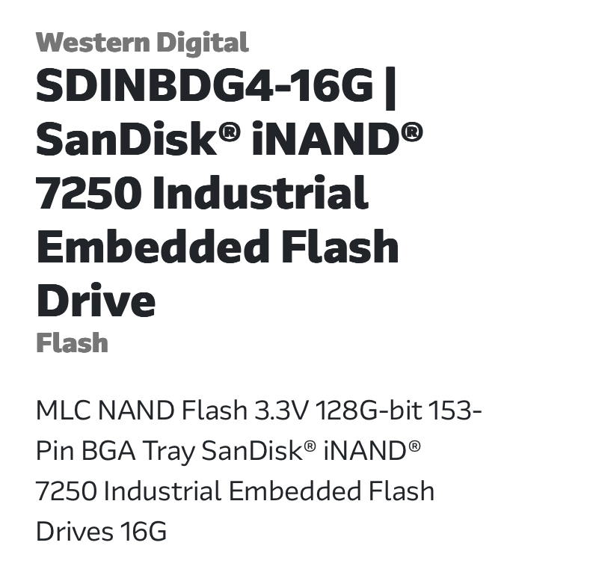
eMMC Chip Specification
Conduct a web search for the string ‘SDINBD64‘ engraved on eMMC
Type: NAND Flash
Capacity: 16 GB
Package: BGA 153
Web search

Slide 11
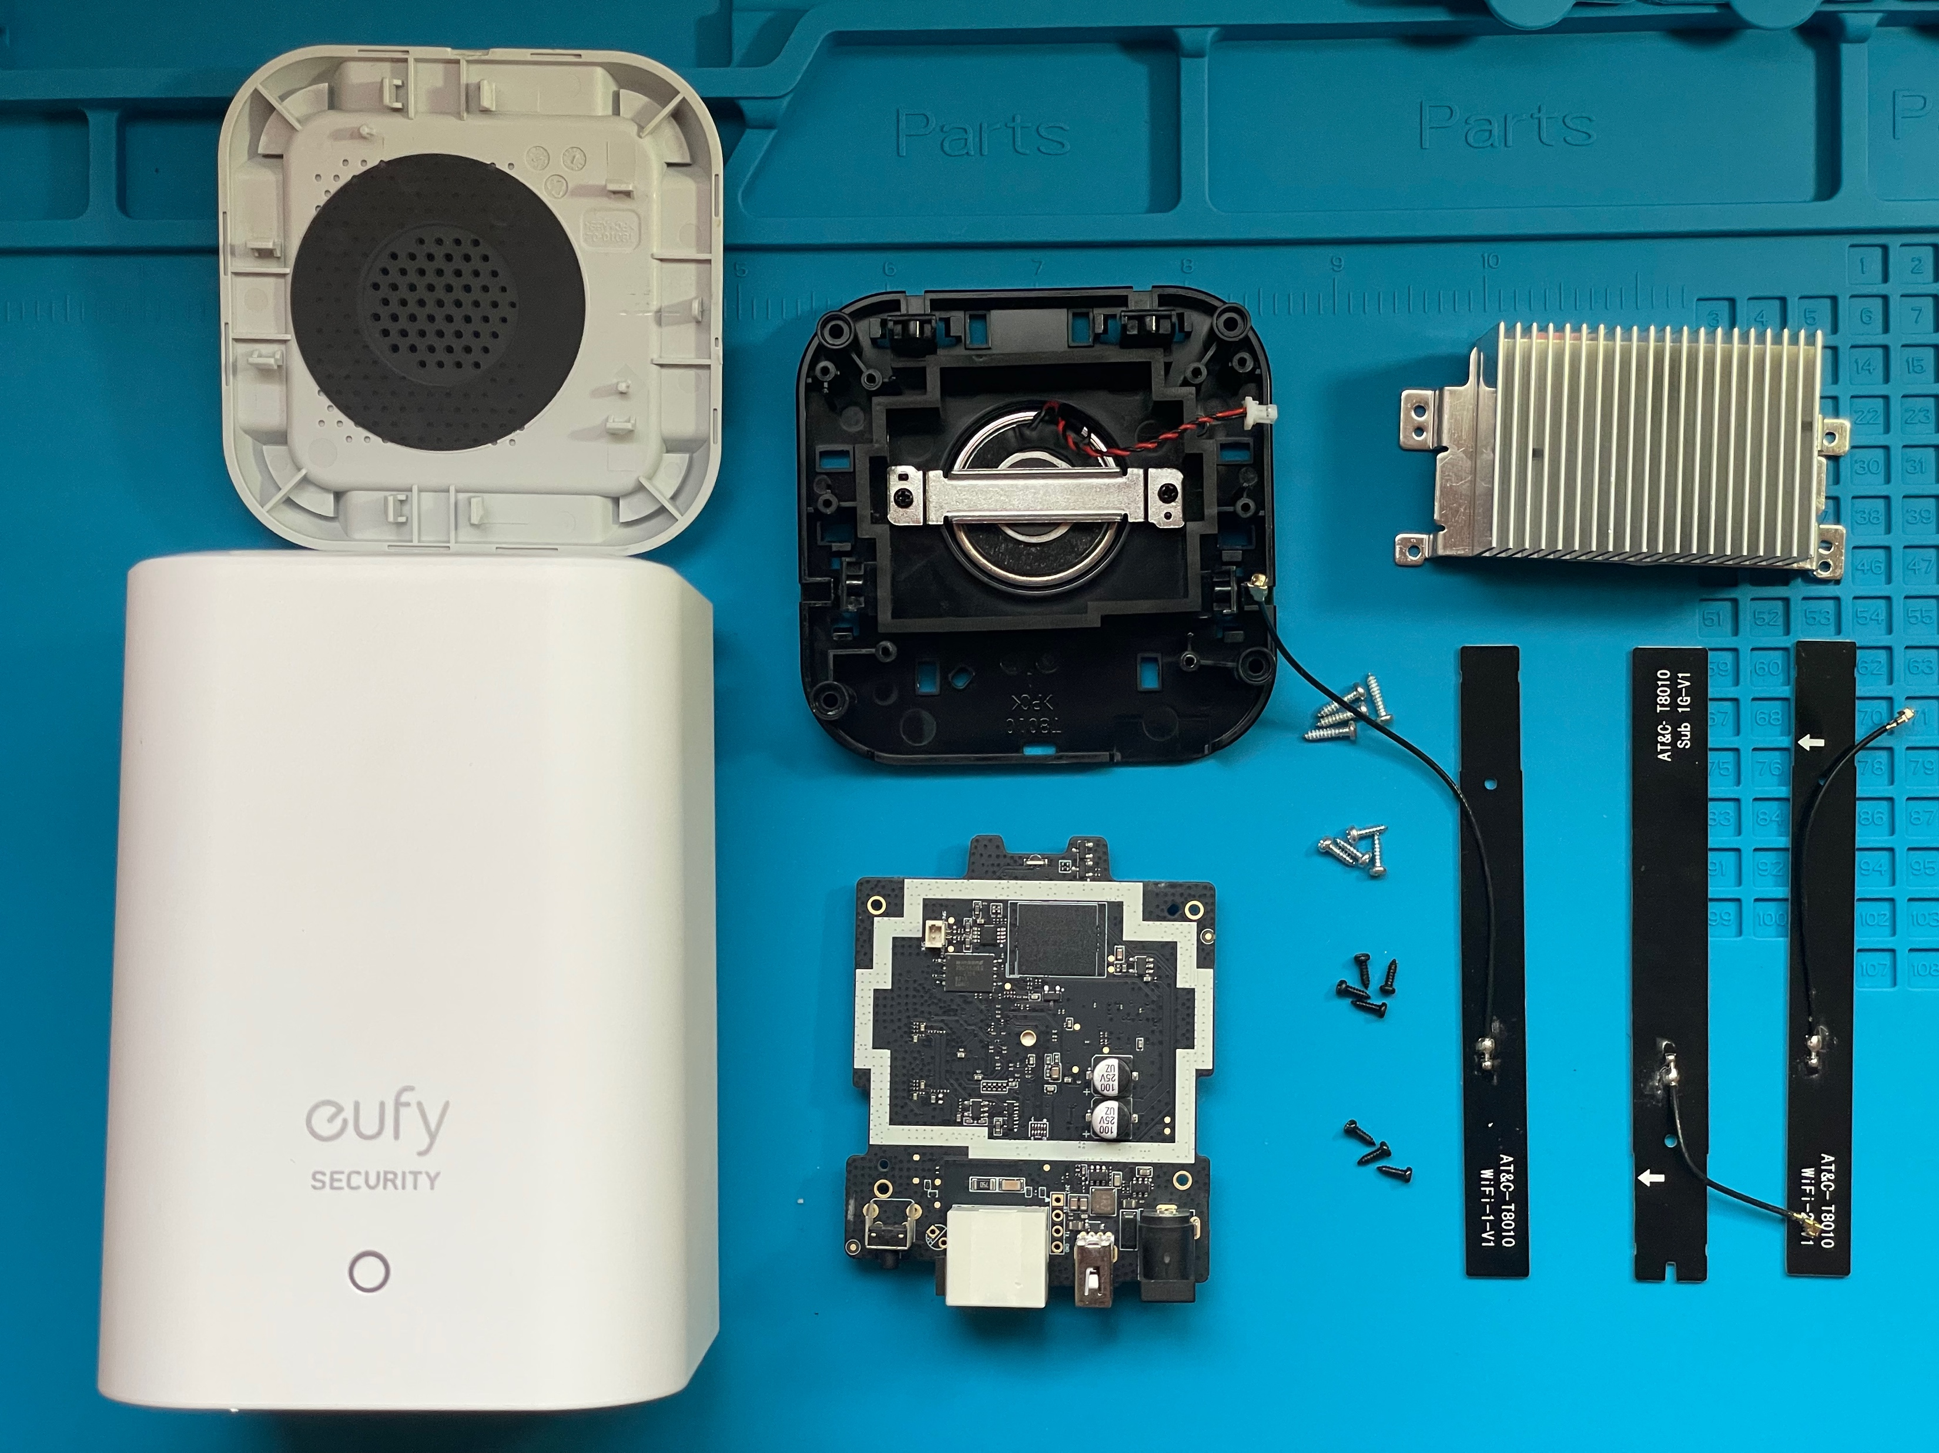
Teardown Complete

Slide 12
Chip-off

Slide 13
Chip-off Process
Apply flux around the eMMC on the logic board.
Set the airflow at 60% on the Rework Station Hot Air Gun.
Configure the temperature as follows:
170°C for the first minute
270°C for the second minute
350°C for the third minute
400°C for the fourth minute
Continuously move the hot air gun nozzle over the eMMC while gently prying it off.
The eMMC should detach smoothly by the end of the fourth minute

Slide 14
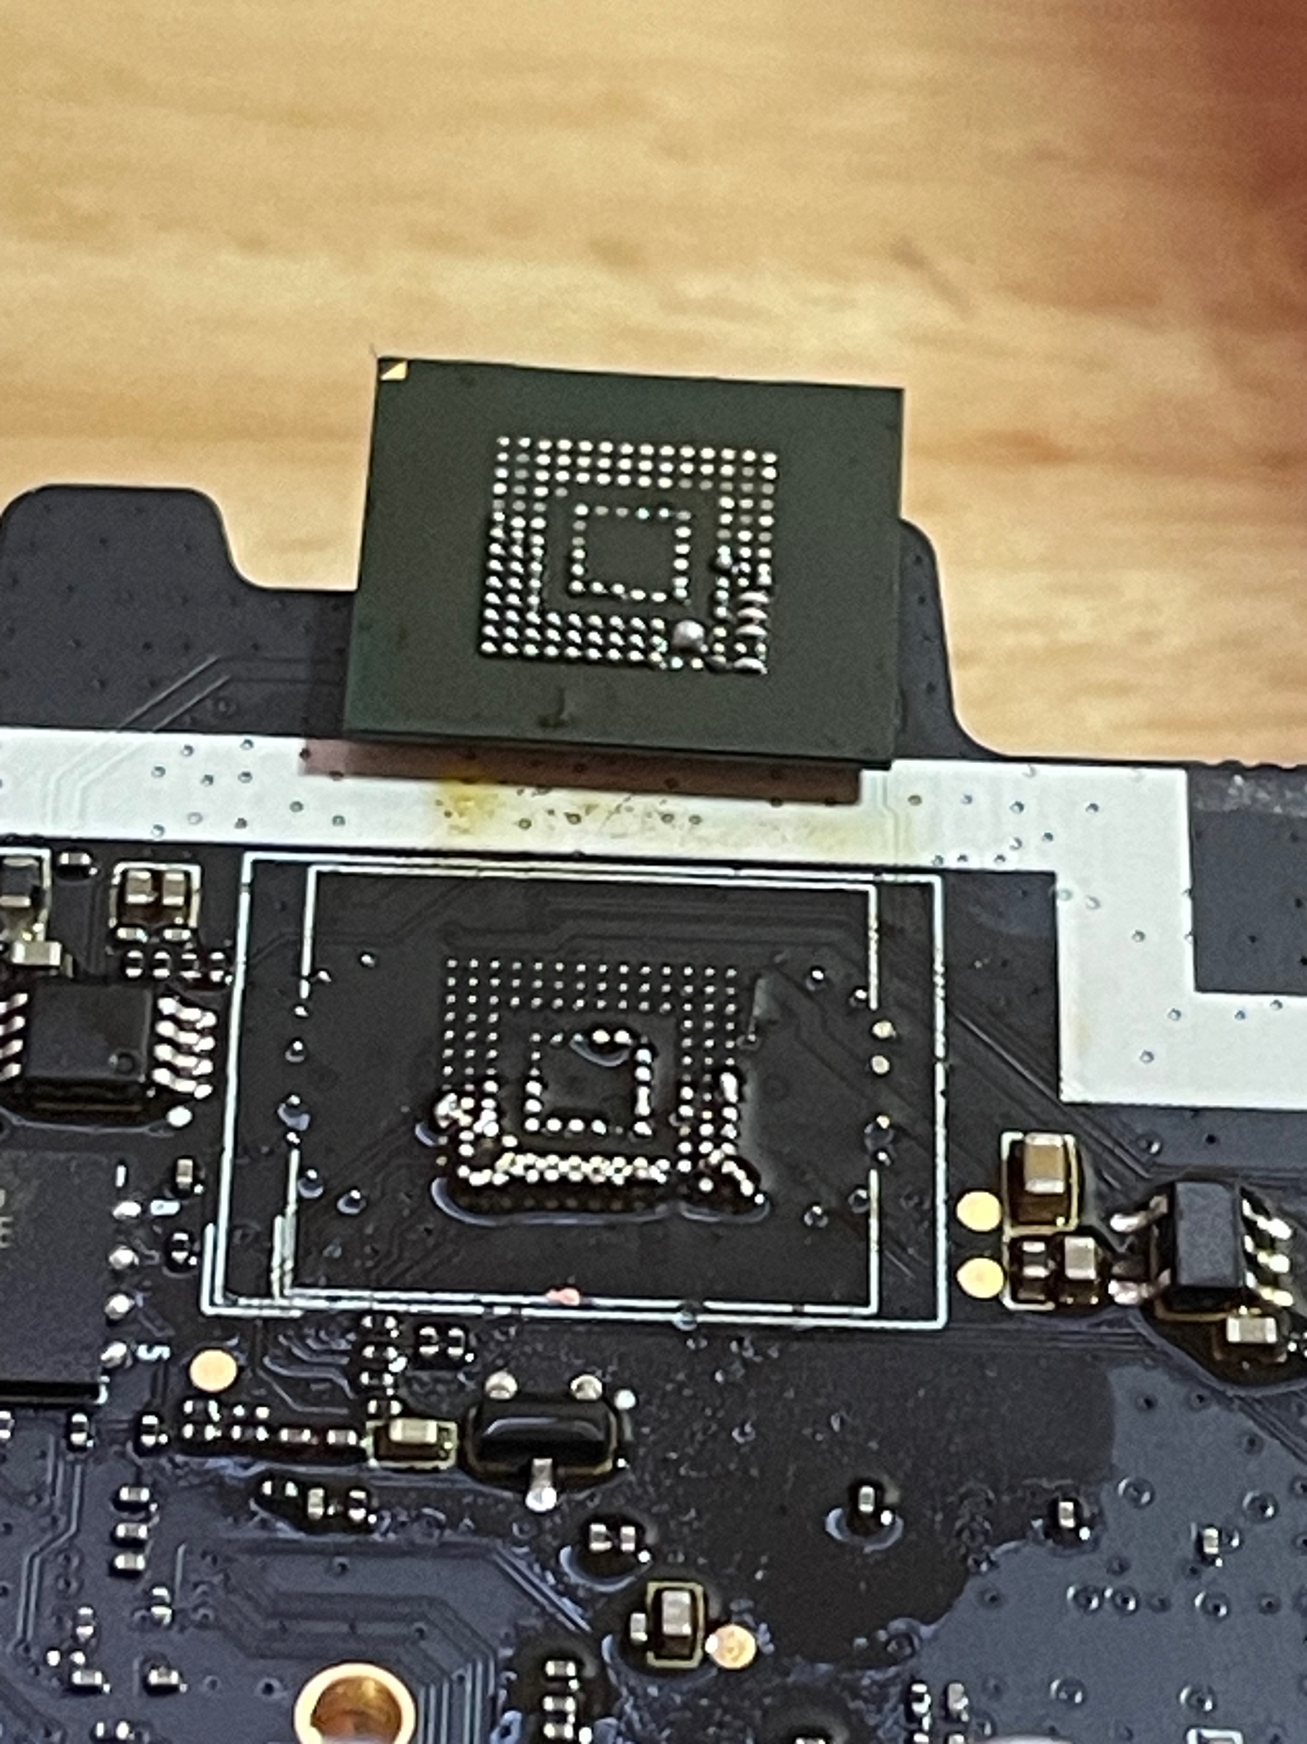
Chip-off
Circuit board before chip-off
Circuit board after chip-off
eMMC removed

Slide 15
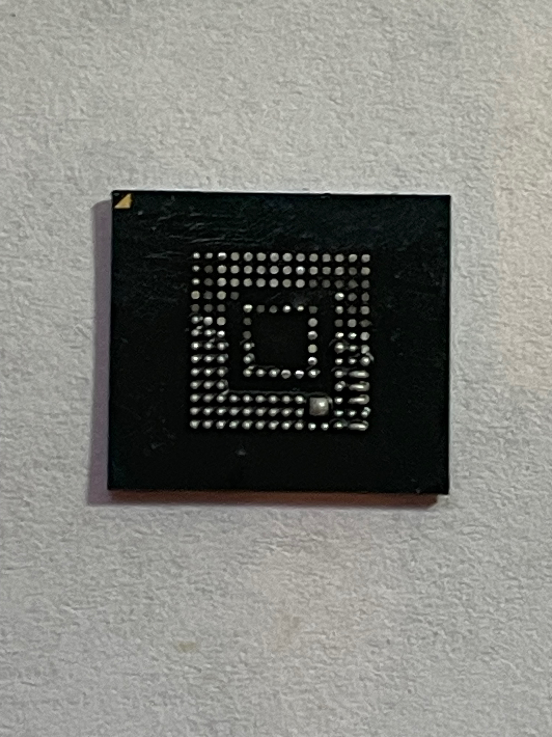
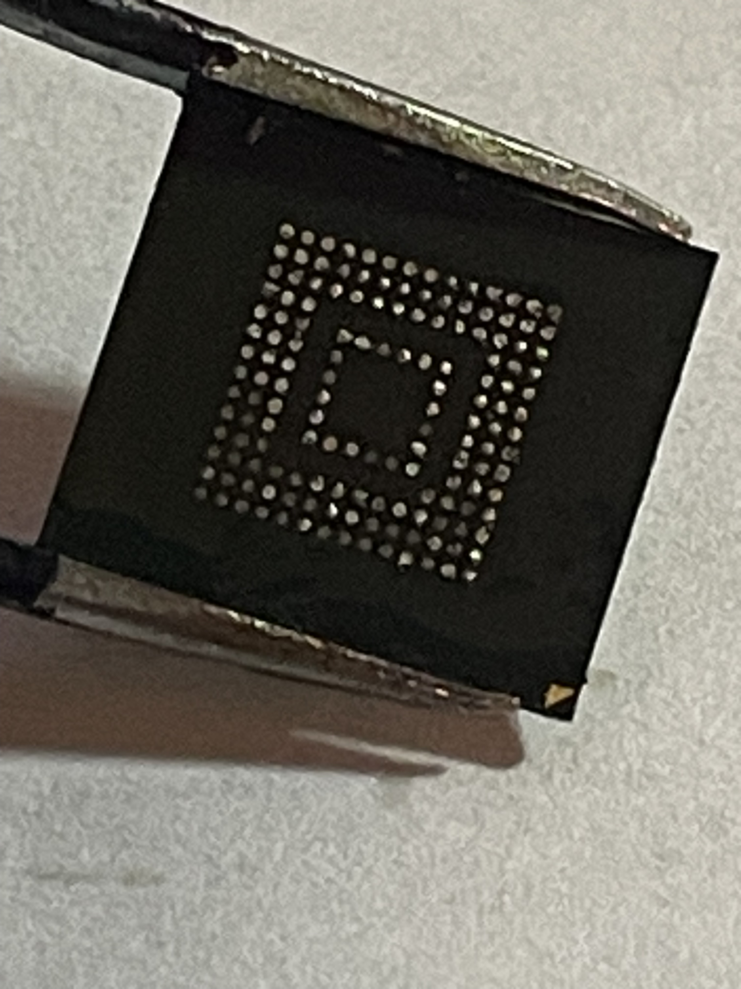
Clean eMMC after chip-off

Slide 16
Image Acquisition

Slide 17
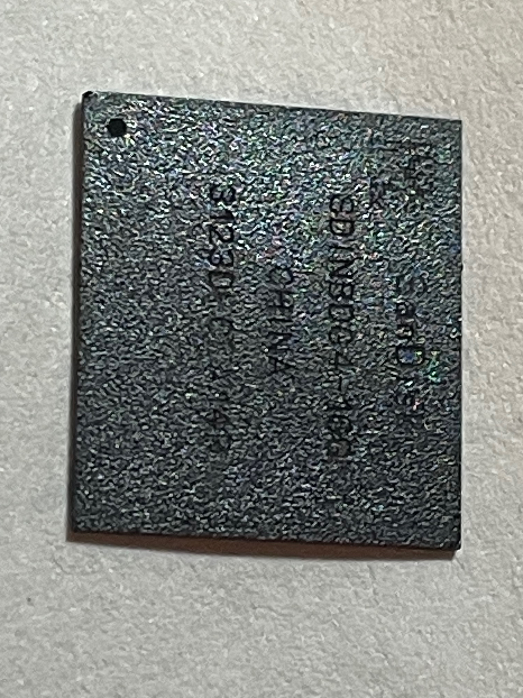
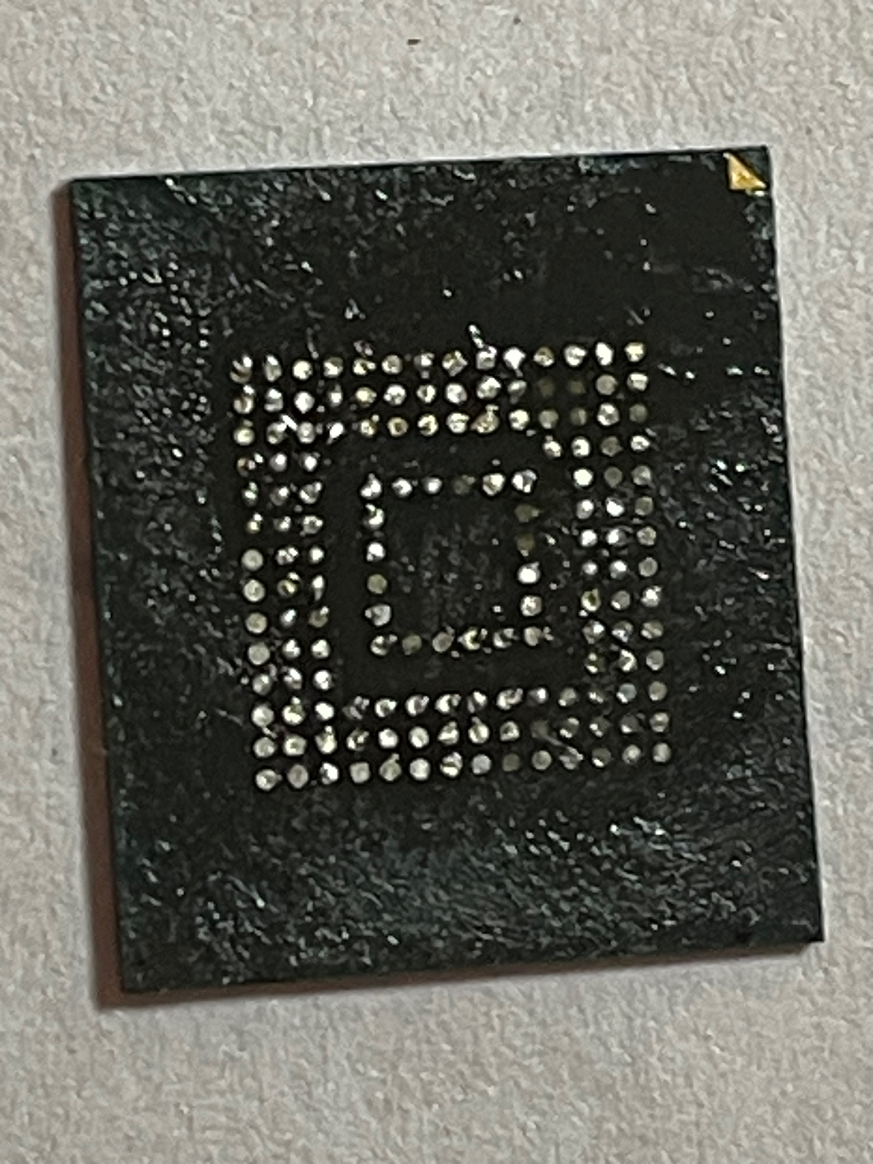
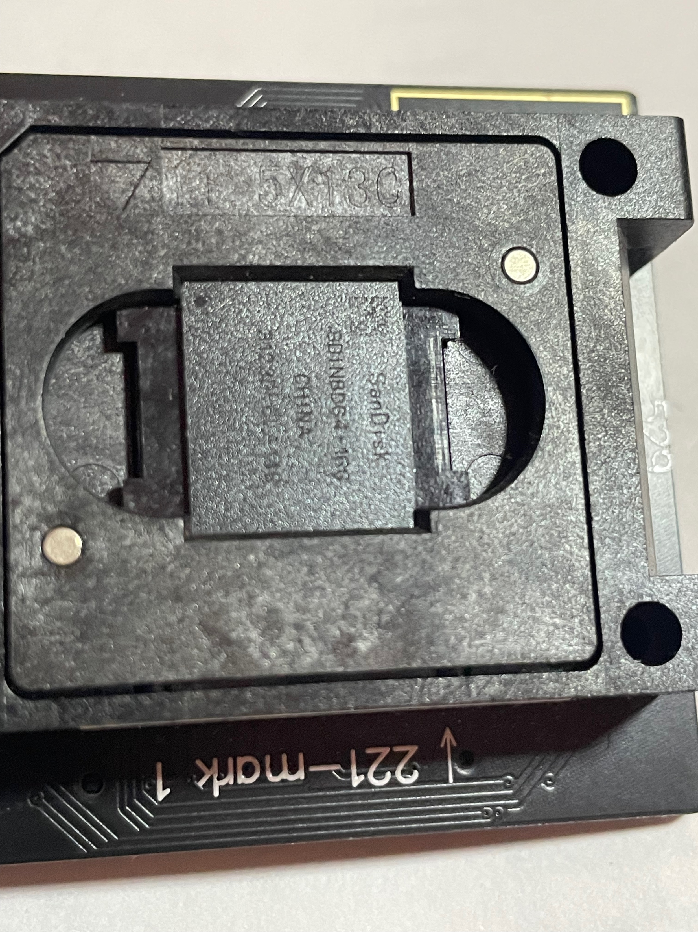
Place eMMC in Easy JTAG socket - d&ot on eMMC & the triangle on socket should align

Slide 18
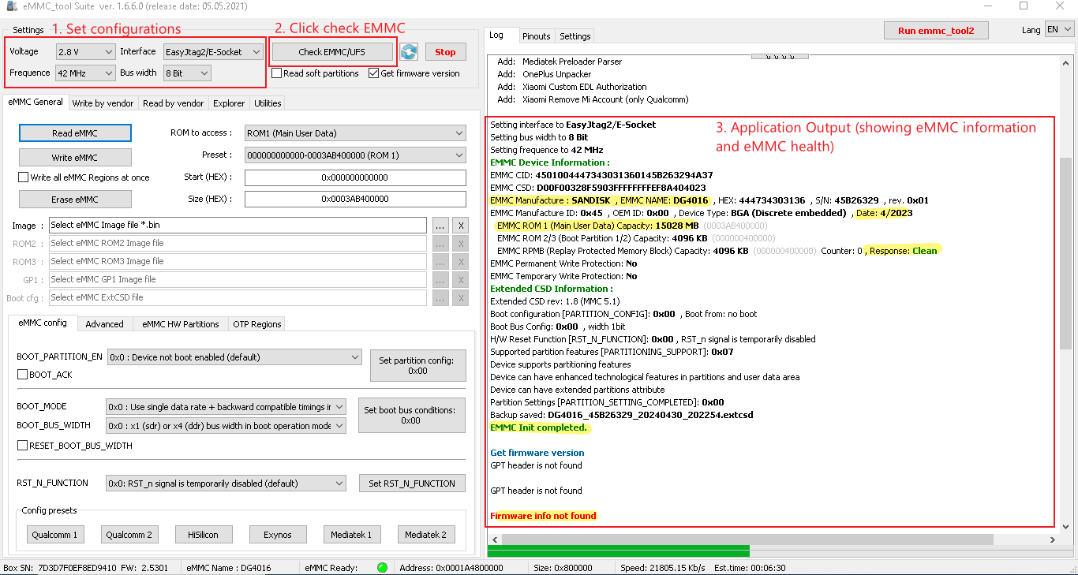
Check eMMC in Easy JTAG Plus

Slide 19
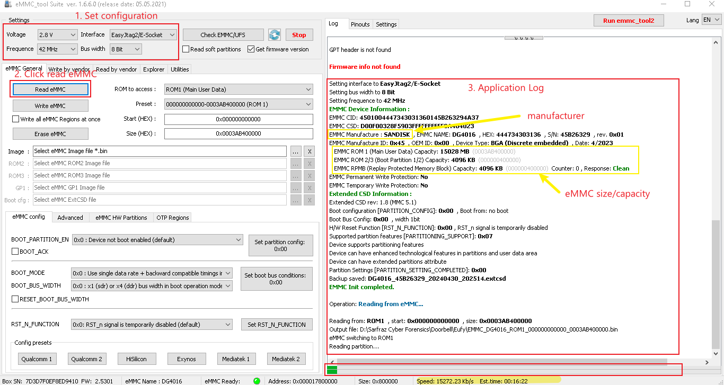
Read eMMC in Easy JTAG Plus

Slide 20
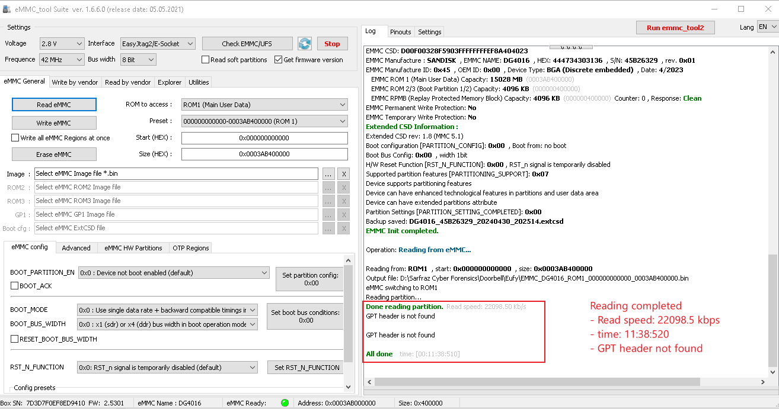
Reading complete

